Slide 1

Marta Shelton, ASE, NASA WFF
Planetary CubeSat Symposium 2018
NASA GSFC
Communications

Slide 2
Deep Space Comm with CubeSats
Challenges:
  Small bodies (6U – 27U) – limited antenna space to cover great and variable ranges for communications
  Planetary Orbit phase arrival constrained by
    Ride Share options availability
    Trajectory – depending on propulsion, you might not get to your planet at periapsis
  Data Rate (RF), mostly low, affects DSN scheduling and cost
    New online DSN costing Tool
  Relays: CubeSat to Asset-in-Orbit – not yet ready for implementation
    Mother-daughter ship: Rx Radio needs dual frequency switching
  If RF: how many frequency bands?
  To deploy, or not to deploy?
  If Optical Comm: to which Ground Station? (large telescope requirement)

Slide 3
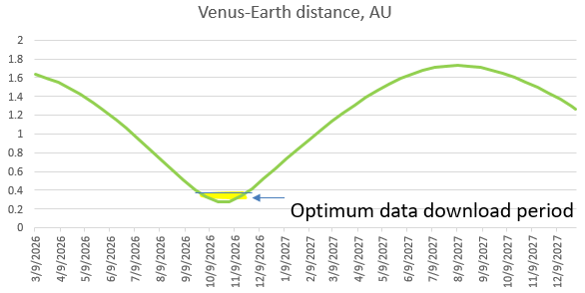
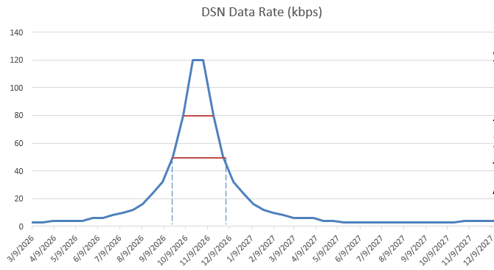
Data Rates, RF – Venus
Scientist: What is my data rate?
Answer: Where and when?
Venus synodic period = 20 months
Optimal D/L = 3 months (15%)
Affects mission operations planning
Rate calculated with 7W radio and >40dBi deployable Ka band antenna

Slide 4
Data Rates, RF – Mars
Mars synodic period = 2 years
  Ideal RF downlink period: 5-7 months
  How to solve the remaining months?
Maven is to transition to a “relay orbit”
  Currently pointing nadir to Mars
  “A study is required into operations to rotate away periodically” – Jim Watzin, Director, Mars Exploration program
  Electra compatible low SWaP UHF Tx radio development
C&DH
Storage
Mars Relay?
DSN 4 kbps rate
Rate calculated with 7W radio and HG X-band antenna
IRIS Transponder (3.8W) – flight heritage MarCO
UHF Rx slice already developed
UHF Tx (or Ka) slice not yet developed
An increased power amplifier would benefit missions with extended durations (not just fly-by)

Slide 5
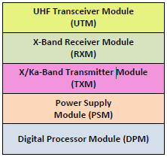
RF – How many frequency bands?
RF Frequency Bands
A new generation solution (JPL):
Universal Space Transponder (UST)
S-band: for “early checkout” wider beamwidths, multiple assets available
X-band: mainstream, preferred uplink from DSN
Ka-band: can produce higher gain antennas given the same area (Beamwidth is the narrowest)
UHF-band: may be ideal for relays; can pair with light-weight UHF dipoles
A CubeSat cannot carry all these radios.
Modular transponders: some of these “slices” are available
In flight re-programmable SDR
Direct-to-Earth and Relay Comm support
Direct Digital Synthesizer (DDS) and analog RF up/down-converters
Additional Science Instrument Integration, e.g.
  bistatic radar receiver and
  broadband planetary emissions receiver
Example Configuration:
Receive at X-band and transmit at both X-band and Ka-band, as well as UHF transmit and receive for a proximity link. In addition, within a supported frequency band, simultaneous multichannel
operation is possible

Slide 6
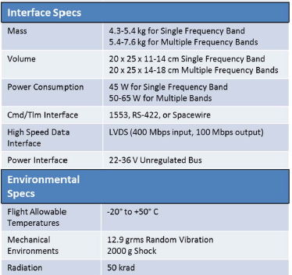
Universal Space Transponder – specs
UST S/X band Engineering Model
DSN & NEN Compatible
TRL-5

Slide 7
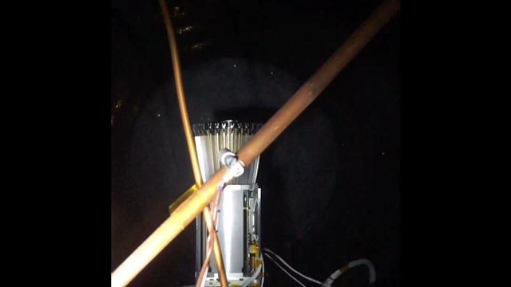
Antennas: To deploy or Not–to-deploy
Tendeg KaPDA Ka-band antenna deployment.
42.7 dBi. Heritage: RainCube, May 2018
Other Hi-Gain Antennas – not inclusive
Designed to deploy, some can be re-enforced to mount pre-deployed.
The aspect that makes some of these low TRL is the mechanical/ deployment/ environmental aspect
More testing is required

Slide 8
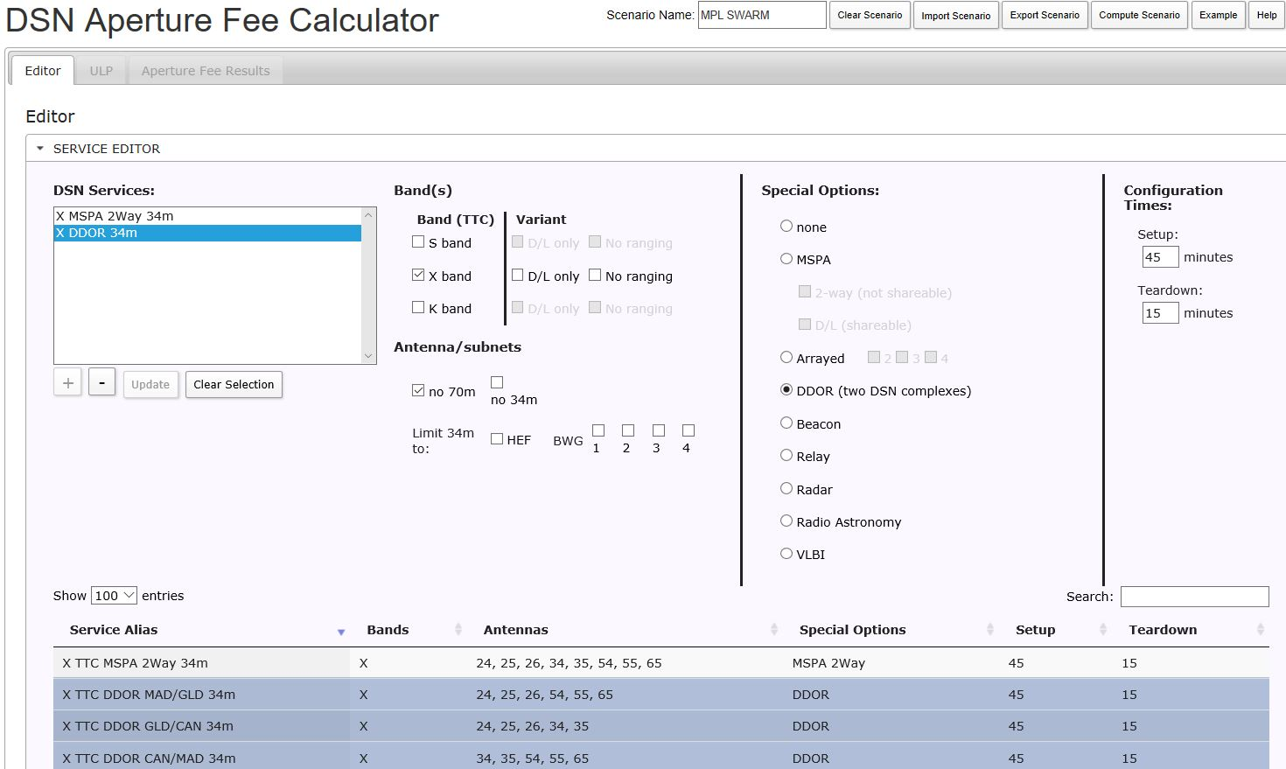
DSN – new LAPS tool: costing
Available to all NASA centers to access
Note: MSPA available, 2 for the price of 1
Shows Setup and Teardown times, affects cost
Choose tracking options
Define Service, Event, Request
View Schedule
Click to calculate cost
Save profile

Slide 9
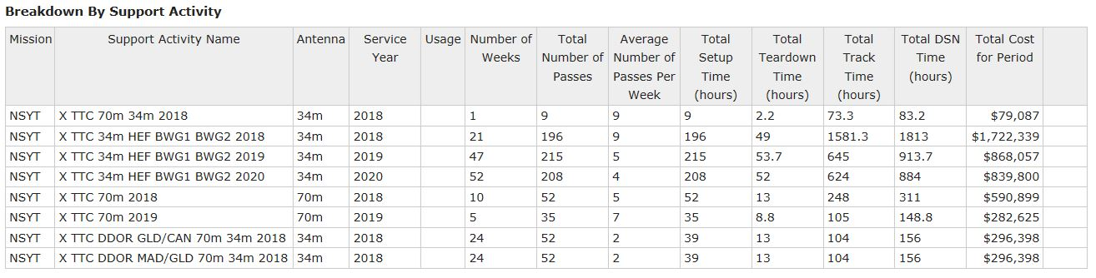
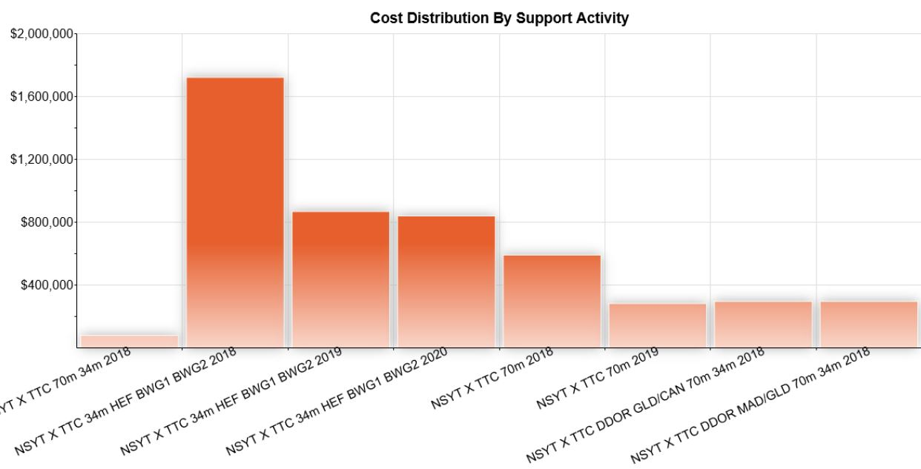
DSN – new LAPS tool: costing 2
Check the AO if this applies: “NASA missions that use standard services will not be charged by SCaN for recurring cost for aperture or per-minute fees. Some fees may apply.”

Slide 10
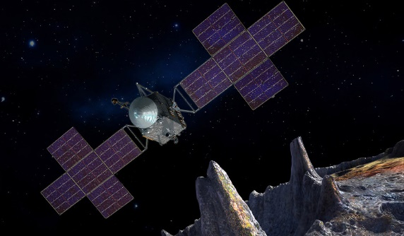
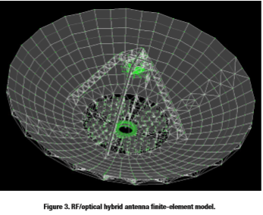
Optical Communications
Disruptive technology, considerably higher data rate than RF
Many upcoming demonstrations/ missions:
  LCRD, O2O, OCSD – most in LEO/GEO/Lunar ranges
  Bulk of Optical ground station plans involve < 1m telescopes, not a good match beyond Lunar distances
Deep Space Optical Comm (DSOC) Demonstration, PSYCHE (JPL) in 2022, going on a 1 AU asteroid mission
  JPL is upgrading the Laser Beacons at Table Mountain
  Will interface Optical Ground Receiving equipment at 5m Palomar Observatory telescope
JPL proposed an RF/Optical Hybrid antenna with mirror elements added to existing 34m RF antenna
Illustration of Psyche
“Psyche will use over 1000 kg of xenon”

