Slide 1
BIG Power BIG Aperture small satellite
Mark Bailey
Director of Business Development, MMA Design
mbailey@mmadesignllc.com
303-877-4119

Slide 2
High Watts per Kilogram (HaWK) Solar Arrays
GSFC Planetary CubeSats Symposium 2018
Aug. 16-17, 2018

Slide 3
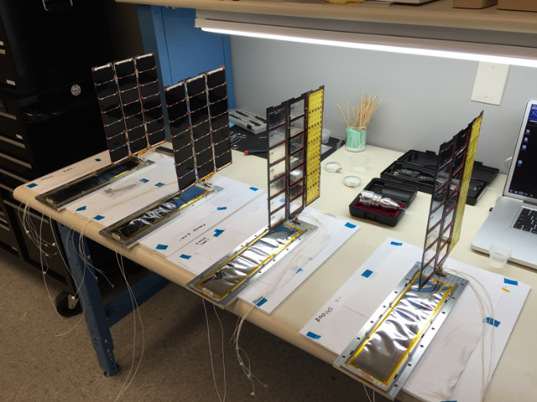
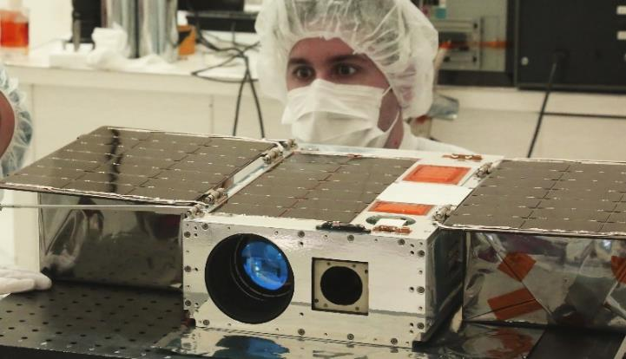
MMA’s “HaWK” Solar Arrays
MMA has been providing solar arrays for CubeSats over 10 years
Focus on “High Watts per Kilogram” (HaWK) and packing efficiency (Watts per m³)
Power requirements have ranged from 42 W (3U) to 220+ (16U) Watts
Single-axis SADA available for 1U- and 2U-width buses
Supports 3U, 6U, 12U, and 16U satellites
GSFC Planetary CubeSats Symposium 2018
Aug. 16-17, 2018

Slide 4
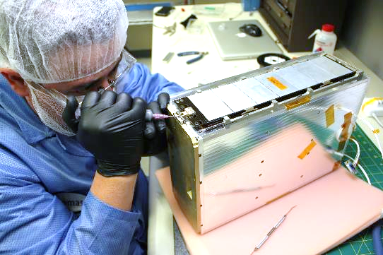
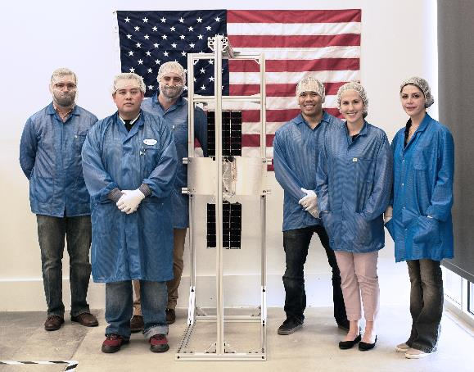
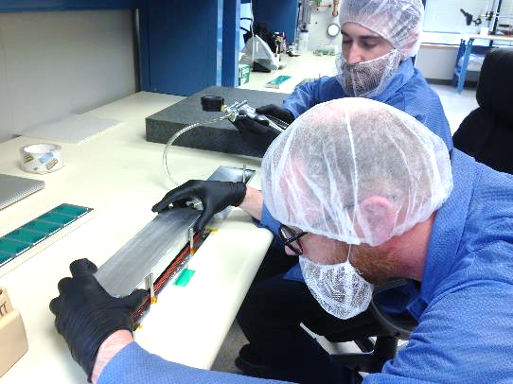
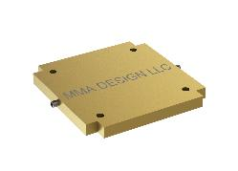
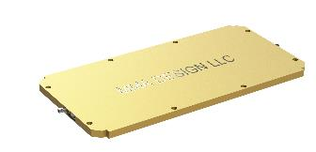
High Performance & Reliability
Packaging to maximize power in any CubeSat deployer
Current state-of-production cells from the best heritage suppliers
Welded strings for thermal extremes and longer life
Robust mechanisms
Rigid Panels/High 1st mode Frequency
Proven workmanship
Optional 1 axis SADA
1U Package for 3U/6U
2U package for 6U/12U
Standard or High Power models
GSFC Planetary CubeSats Symposium 2018
Aug. 16-17, 2018

Slide 5
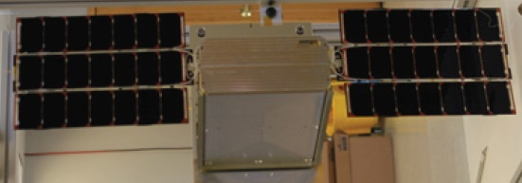
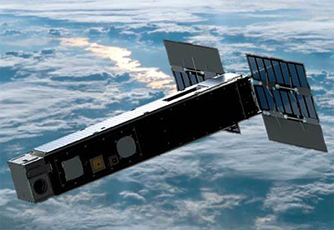
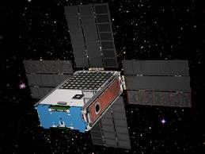
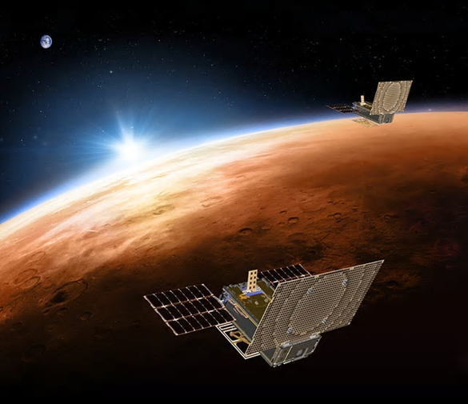
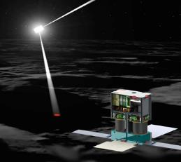
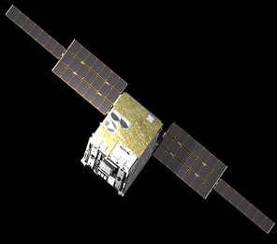
HaWK Array Heritage 100% Success Rate
GSFC Planetary CubeSats Symposium 2018
Aug. 16-17, 2018

Slide 6
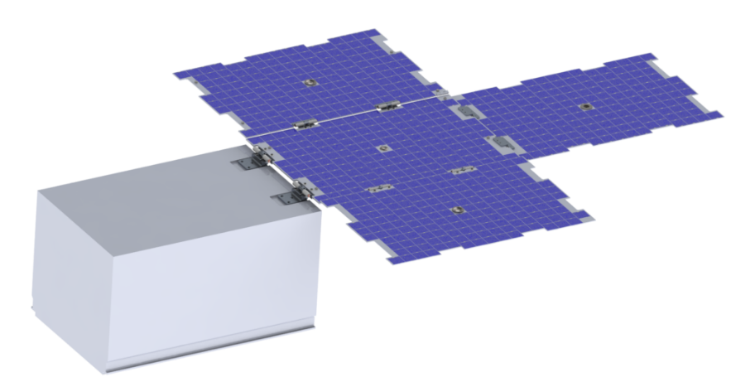
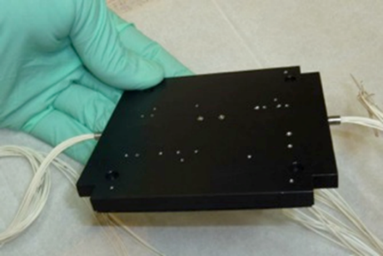
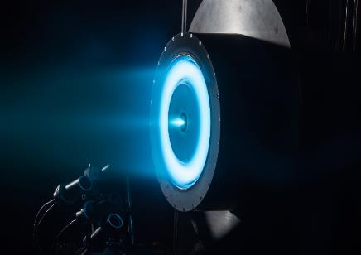
Pushing Performance
MMA is currently advancing CubeSat Power to new levels with support from an Air Force SBIR Phase II grant.
Technology/Performance Advances
~200+ watts in a 6U/12U package
XL Power 1 axis SADA
Increased voltage options as small as CubeSats 28-100V+
Enables direct-drive power for SEP Thrusters
GSFC Planetary CubeSats Symposium 2018
Aug. 16-17, 2018

Slide 7
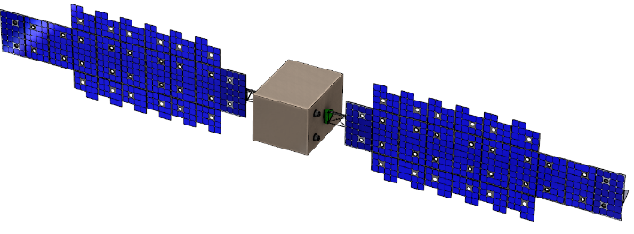
Advanced Packaging Approach for SmallSat Solar Arrays
MMA’s rHaWK technology is targeted for ESPA-class small satellites and larger
Architecture is efficient at power levels greater than 500 watts, and up to multiple kilowatts
Concept combines features of MMA’s lightweight HaWK solar panels and deployable tape-boom technologies (high TRL)
Multiple HaWK panels and deployable side panels are deployed and supported by a deployable tape-spring truss
The assembly can be attached to a SADA
Nanosat Truss
HaWK Panels
24x28x36 inch ESPA Bus
Typical high-performance array targets: 120 W/kg, 40kW/m³
rHaWK: 130+ W/kg, ~93 kW/m³
2 kW ESPA Array
(BOL, AM0, 28°C)
GSFC Planetary CubeSats Symposium 2018
Aug. 16-17, 2018

Slide 8
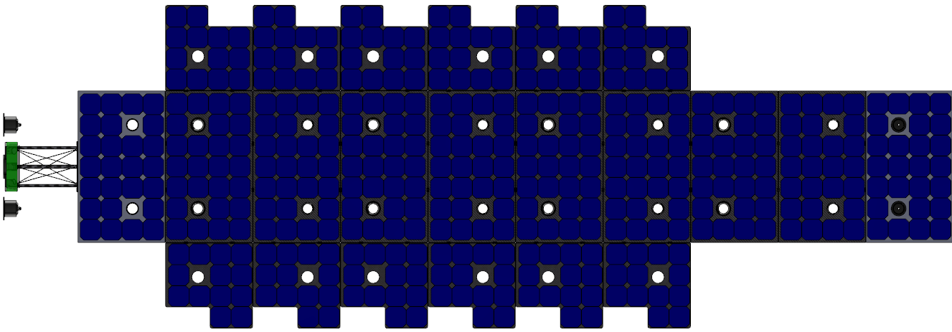
1 kW rHaWK Wing
[3.66 m]
144 in
[300 mm]
12.0 in
[1.24 m]
49 in
Bus Interface
HaWK panels attach to boom at every other hingeline
GSFC Planetary CubeSats Symposium 2018
Aug. 16-17, 2018

Slide 9
Comparison to Tensioned Blanket
The rHaWK architecture is similar to tensioned-blanket arrays but offers the following benefits and advantages:
Array does not require tension, relaxing the stiffness and strength requirements (and mass) of the boom
Array has a reduced effective length (multiple attach points along the length), increasing the first mode compared to a blanket that is attached only at the tip and root.
Rigid substrates offer improved radiation shielding and thermal management over flexible blanket substrates
MMA boom does not use a canister (better mass and packaging efficiency, W/kg & kW/m³)
Stowed form factor is more friendly and flexible for SmallSats and small launch vehicles
Array stows as a rectangular stack of rigid panels
Boom does not require a deployment canister
GSFC Planetary CubeSats Symposium 2018
Aug. 16-17, 2018

Slide 10
Frequency Specific MMA Deployable High-Gain Reflectarray (DaHGR) (1U+)
GSFC Planetary CubeSats Symposium 2018
Aug. 16-17, 2018

Slide 11
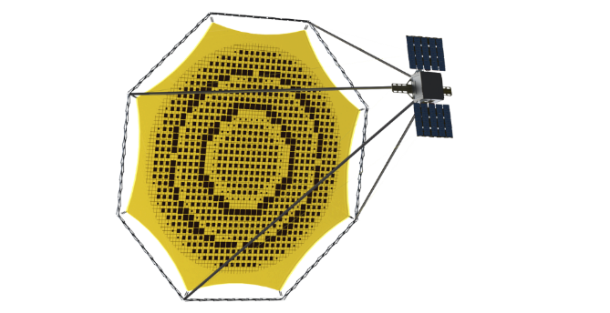
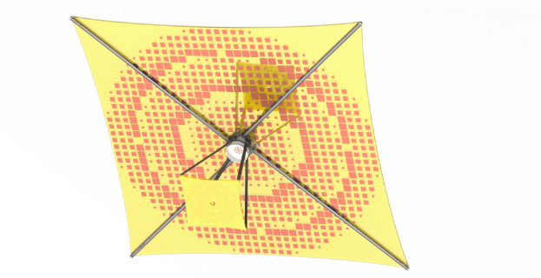
Deployable High Gain Reflectarray (DaHGR)
Patent-pending designs create reflectarray on thin film membranes
Leverages high TRL design elements
TRL-9 dragNET De-orbit System and launch restraints
TRL-8 FalconSAT-7 diffractive optical membrane
TRL-9 in 2018
Flight heritage composite tapes
Full tape deployer at TRL-9 in 2018/19
Efficiency comparable to rigid reflectors (~60%)
Frequencies up to Ka-Band
Possibly higher, aperture dependent
Membrane Reflectarray technology allows flat/planar surfaces instead of parabolic/curved, trading large bandwidth for reduced complexity
P- DaHGR Antenna Architecture (patent pending)
T-DaHGR Antenna
(patent pending)
GSFC Planetary CubeSats Symposium 2018
Aug. 16-17, 2018

Slide 12
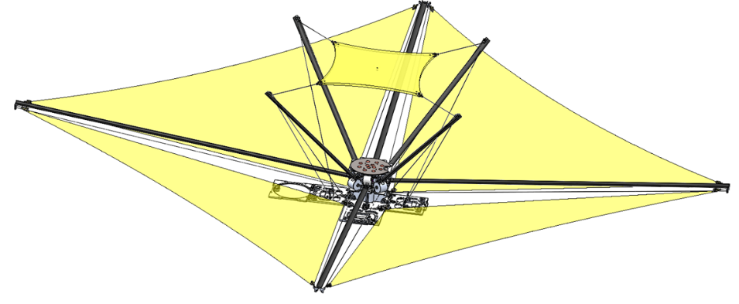
T-DaHGR Overview
UHF–Ka band
High stiffness
Low RF losses
Equivalent to conventional reflectors
Up to 20+% bandwidth
Thermally stable
1 – 20 m aperture
0.5 - 1.00 m²/U packing efficiency
1U – 25U volume
GSFC Planetary CubeSats Symposium 2018
Aug. 16-17, 2018

Slide 13
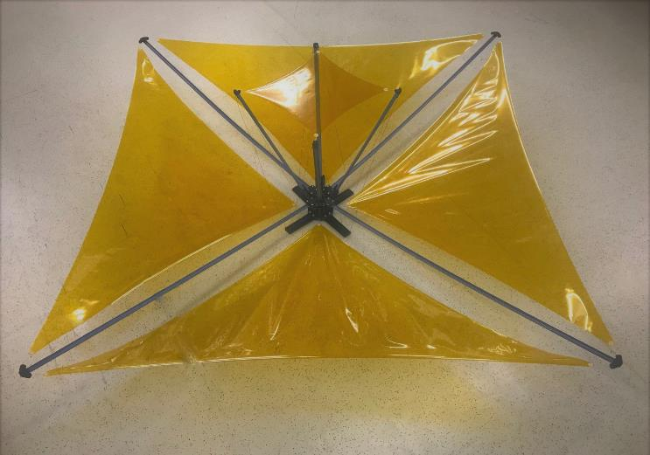
Top Level System Working Requirements
Parameter | Estimated Performance
Mass (kg) | ≤ 2
Stowed Volume (mm) | 100 x 100 x 100
Deployment Duration (sec) | < 600
Active Aperture Area | ≥ 1 meter diameter
Center Frequency (GHz) | 8.2 - 8.45
Gain (dBi) | > 35
Beamwidth (degrees) | 2.3
Bandwidth (MHz) | > 10%
Return Loss | < 2:1 VSWR
T-DaHGR System
GSFC Planetary CubeSats Symposium 2018
Aug. 16-17, 2018

Slide 14
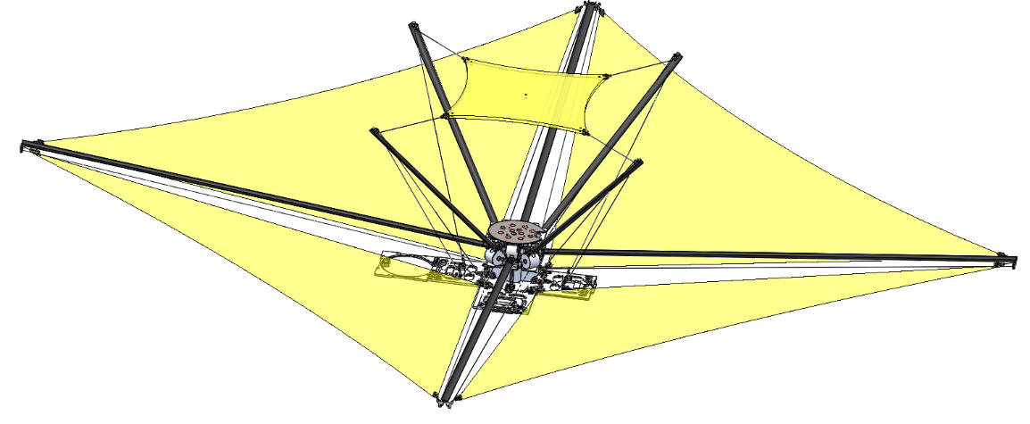
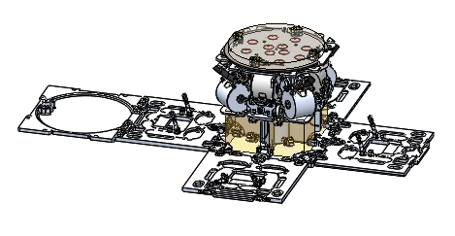
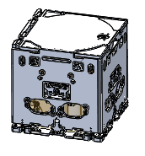
T-DaHGR System Overview
Secondary Reflectarray Membrane
Primary Reflectarray Membrane
(Active RF Area ~ 1M diameter)
100 mm
100 mm
100 mm
Stowed
Restraint door released
Deployed
RF Feed
GSFC Planetary CubeSats Symposium 2018
Aug. 16-17, 2018

Slide 15
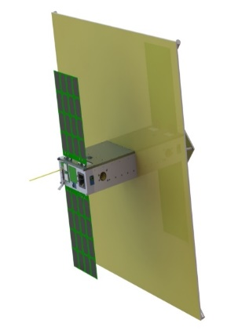
Experiment Technical Information
Apogee: 550 nominal +/- 50 km
Perigee: 550 nominal +/- 50 km
Inclination: 55 nominal
Mass: 10.67 kg
Dimensions: 11 x 23 x 36 cm
Power: 28 W
Objective
Demonstrate High Data Rate Downlink and Uplink Capabilities in small SWaP Form Factor
Demonstrate Code Division Multiple Access (CDMA) Downlink and Uplink
Characterize the MMA T-DaHGR deployable X-Band antenna on-orbit performance
Characterize the Chip Scale Atomic Clock (CSAC) on-orbit performance
Tech Transition
High data rate comm capabilities for use in SmallSat community
Spread spectrum CDMA capabilities for use in SmallSat community
High gain 1U deployable antenna for use in SmallSat community
Advancement in high rate communication technology of interest to cutting edge industry leaders within the SmallSat community
MAXWELL fully deployed with MMA antenna
Sponsor: AFRL
End Users: DoD, NASA, NOAA, Commercial SmallSat
Experiment Type: Comm
Flight Ready Date: September 2020
GSFC Planetary CubeSats Symposium 2018
Aug. 16-17, 2018

Slide 16
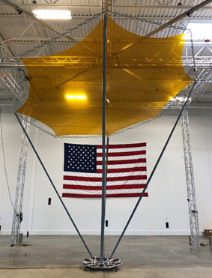
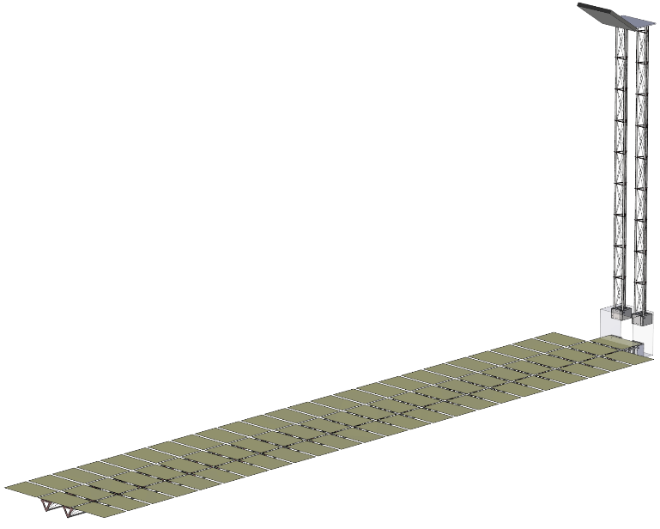
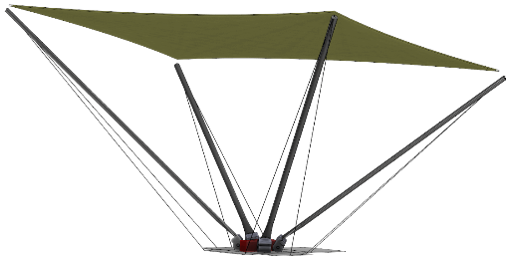
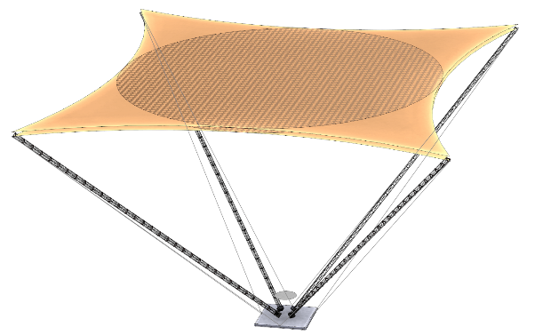
DaHGR Options
GSFC Planetary CubeSats Symposium 2018
Aug. 16-17, 2018

Slide 17
Conclusions
MMA HaWK Arrays offer several benefits to interplanetary missions:
Exceptional packaging efficiency
State-of-the-art for power density at up to 130 W/kg
High reliability, industry-heritage rigid-panel array materials and processes
Rigid substrates offer radiation shielding and thermal stability for long-duration and deep space missions
Options for structural depth offer high stiffness and strength for delta-v maneuvers
Canister-free, linearly-deploying boom structure is available for deploying or supporting other sensors
Scalable architecture enables 220+ watts on CubeSats and 6+ kW on ESPA buses
GSFC Planetary CubeSats Symposium 2018
Aug. 16-17, 2018

Slide 18
Conclusions
MMA DaHGR offers several benefits to interplanetary missions:
Exceptional packaging efficiency
Demonstrating X Band gain at 35+ dBi; gain
Potential for implementation up to Ka Band with increased gain
High reliability, industry-heritage materials and processes
Alternative configuration options
Cassegrain T-DaHGR - ready for flight by 2019
Pantograph P-DaHGR - qualified and delivered, flight in 2018/19
Direct fed off-axis T-DaHGR – completed CDR
Transmissive Lens – conceptual design proposed for 2019 funding
Rigid Substrate (R-DaHGR) – funded for TRL advancement
Scalable architecture enabling 1 m² on a CubeSat up to 50+ m² on an ESPA Grande bus
GSFC Planetary CubeSats Symposium 2018
Aug. 16-17, 2018

Slide 19
Delivering Innovative Deployable Solutions
GSFC Planetary CubeSats Symposium 2018
Aug. 16-17, 2018

