Slide 1
State-of-the-Art for Small Satellite Propulsion Systems
Khary I. Parker
NASA/Goddard Space Flight Center
3rd Planetary CubeSat Science Symposium
NASA/Goddard Space Flight Center
Greenbelt, MD
August 16-17, 2018

Slide 2
Agenda
State-of-the-Art Overview
Obstacles to System Development
SmallSat Propulsion System Performance
Technology Gaps
Conclusion

Slide 3
State-of-the-Art Overview
SmallSats enable low-cost access to space.
Their uses and capabilities are growing to the point where a propulsion system is required.
Current state-of-the-art for SmallSat propulsion systems is rapidly evolving. The technology readiness levels (TRLs) of many systems have increased over the past few years.
SmallSat propulsion system SoA:
  Cost: Many systems still include high development costs
  Performance: has slightly increased, but room for improvement.
  Reliability: radiation tolerance has improved; operational envelop need to be stretched to find technological limits.

Slide 4
Obstacles to System Development
Reliability
  Low quality standards
  Components not tested in harsh environments (radiation, thermal, vibration)
Maturity
Safety
  Vendors are paying attention to established safety standards.
  Range Safety (NASA & DoD) are now open to adjusting standards for higher risk SmallSat missions.
Cost
  See Reliability
  Power Processing Unit (PPU) development is hindered by availability of space-flight qualified components (e.g., radiation hardened) at a low cost
  Exceeding or well-documenting U.S. Range Safety compliance demonstrating that the system will not create undesirable risk.

Slide 5
NASA SmallSat Interplanetary Mission Studies
Performance
  Delta-V: < 1.0 km/s
  Isp: < 230 sec
  Thrust: < 1.0 N per thruster
  Propellant Mass Fraction: 50% - 60%
Power Consumption
  Chemical Prop: ~40W @ 28 Vdc (driven by catbeds)
  Electric Prop:
    Max Power: ~80W @ 12 Vdc
    Thrust/Power: 16 mN/kW

Slide 6
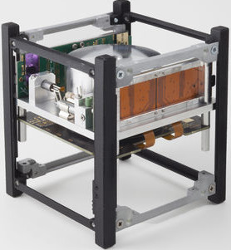
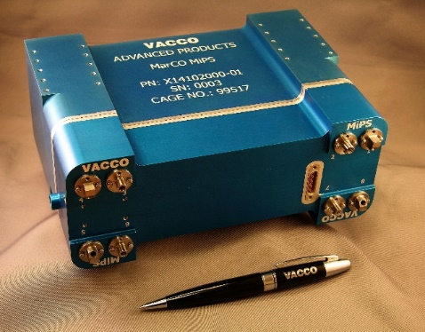
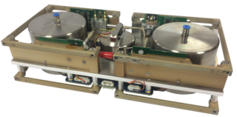
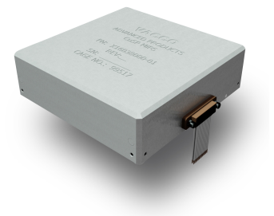
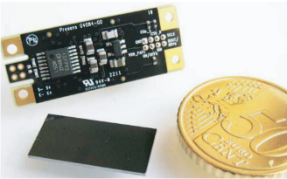
SmallSat Cold Gas Propulsion
NanoProp Cold Gas Propulsion System
(GOMSpace)
Propellant: Isobutane
System Mass/Size
  3U
    Wet Mass: 0.35 kg (Prop: 0.05 kg)
    Dim: 10 x 10 x 5 cm
  6U
    Wet Mass: 0.90 kg (Prop: 0.13 kg)
    Dim: 20 x 10 x 5 cm
Performance:
  3U
    Thrust: 0.01 to 1 mN (x4 thrusters)
    Specific Impulse: 60 – 110 sec
  6U
    Thrust: 1 to 10 mN (x4 thrusters)
    Specific Impulse: 60 – 110 sec
Power Req: < 2.5 W
TRL: 7
Development Status:
  1 unit flew on Tianwang-1 (China)
  Units on order for future commercial flights
Cold Gas Micro Propulsion System
(VACCO)
Propellant: R-236fa
Custom Mass/Size:
  MarCO:
  CuSP:
Custom Performance:
  Thrust: 3 - 25 mN
  Specific Impulse: 38 – 40 sec
Power:
  Standby: 2.1 W/unit
  Firing: At 100% DC, thruster has unlimited burn time. At DC ≤ 100%, recommended maximum burn time is ≤ 15 minutes.
    100% duty cycle: 10.5 W/unit
    76% duty cycle: 8.0 W/unit
TRL: 7
Development Status:
  2 units flying on MarCO (JPL)
  1 unit on order for CuSP (GSFC)

Slide 7
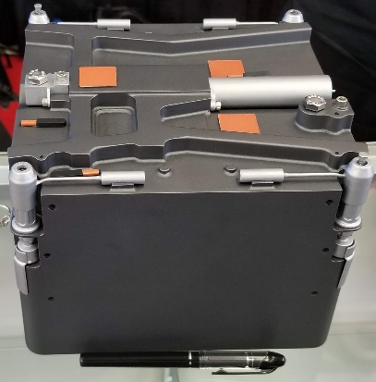
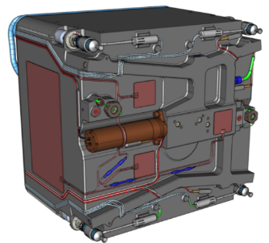
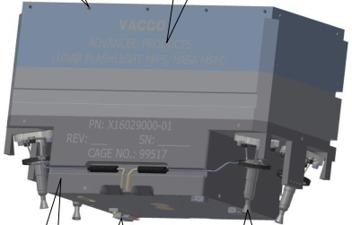
SmallSat Green Propulsion
MPS-135 Green Propulsion System
(Aerojet-Rocketdyne)
Propellant: AF-M315E
6U System Mass/Size:
  Mass: 11.46 kg (Prop.: 7.05 kg)
  Dim: 22 x 21 x 16 cm
Performance:
  Thrust: 2.4 N (4 x 0.6 N thrusters)
  Specific Impulse: 220 sec
  MEOP: 50.0 psi (Gaseous N2)
Power: 35.0 W
  Pre-Burn: 28.0 W (x4 Catbed heaters, on before burn only)
  During Burn: 12.0 W (thruster valves, pump, system heaters, Catbed htrs off)
  Standby: 5.0 W (system heaters)
TRL: 5
Development Status:
  Thrusters undergoing qualification testing
  Flight in 2019
Green Propellant Micro Propulsion System
(VACCO)
Propellant: LMP-103S
2U System Mass/Size:
  Mass: 5.06 kg (Prop.: 2.06 kg)
  Dim: 22.5 x 14 x 10.4 cm
Performance:
  Thrust: 0.4 N (4 x 0.1 N thrusters)
  Specific Impulse: 200 sec
  MEOP: 330.0 psi (Gaseous N2)
Power: 45.0 W
  Pre-Burn: 35.0 W (x4 Catbed heaters, on before burn only)
  During Burn: 20 W (thruster valves, system heaters, Catbed htrs off)
  Standby: 10.0 W (system heaters)
TRL: 5
Development Status:
  Thrusters undergoing qualification testing.
  Flight in 2019 on Lunar Flashlight.

Slide 8
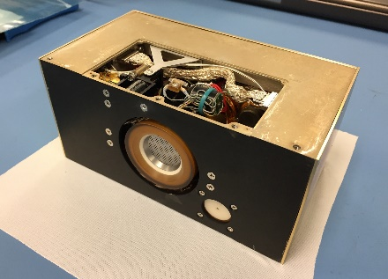
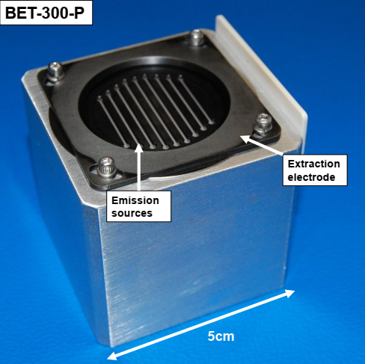
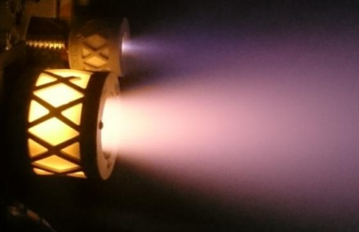
SmallSat Electric Propulsion
BIT-3 RF Ion Thruster
(Busek)
Propellant: Iodine
2U System Mass/Size:
  Wet Mass: 3 kg (Prop: 1.5 kg)
  Dim: 18.0 x 8.8 x 10.2 cm
Performance:
  Thrust: 1.24 mN
  Specific Impulse: 2646.4 sec
Power: 80.0 W
  Thrust-to-Power: 16 mN/kW
  Input Voltage: 12 Vdc
TRL: 5
Development Status:
  In qual testing for Lunar IceCube and LunaH-Map
BET-300 Electrospray Thruster
(Busek)
Propellant: EMI-Im Ionic Liquid
1U System Mass/Size:
  Wet Mass: 3 kg (Prop: 1.5 kg)
Performance:
  Thrust: 0.3 mN
  Specific Impulse: > 1000 sec
Power: 6 W
  Thrust-to-Power: 50 mN/kW
  Input Voltage: 12 Vdc
TRL: 3
Development Status:
  In development under NASA SBIR.

Slide 9
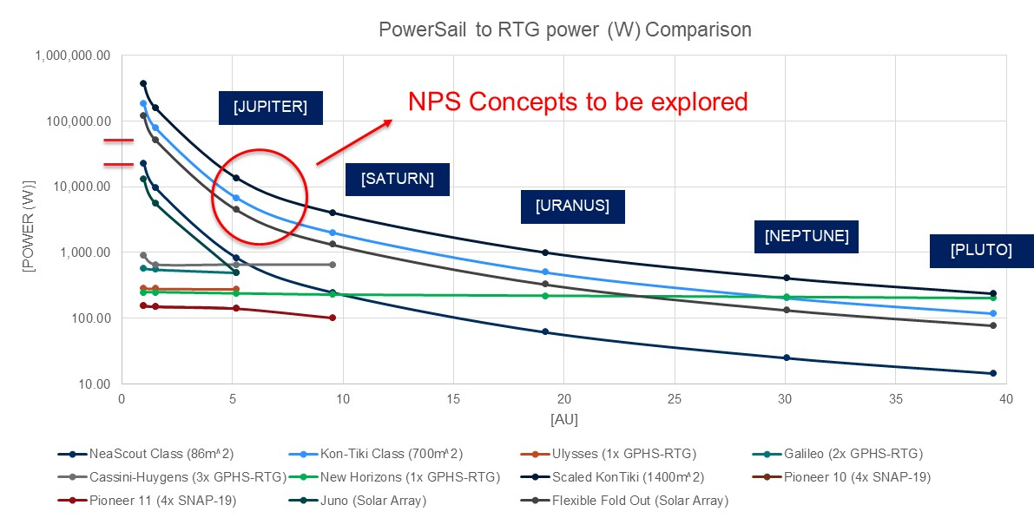
SmallSat Propellant-less Propulsion
NASA/MSFC is developing solar sail technology for deep space missions, such as NEA Scout.
They are also developing technology to integrate solar power cells into solar sails with the NASA PowerSail (NPS).

Slide 10
Technology Gaps
Chemical Propulsion
  Volume efficient propellant storage for interplanetary mission.
  High density/High Isp propellant with accompanying thruster hardware:
    Air Force HAN-based Propellant (AF-M315E):
      Busek is winding down green propellant thruster development
      Aerojet developed and built AF-M315E propulsion systems
        GPIM
          Developed GR-1 1.0N thruster.
          Due to launch Nov. 2018. Will be first flight for AF-M315E propellant.
        Developed Modular Propulsion Systems (MPS) for SmallSat use.
          Miniature version of GR-1 (GR-M1) in development.
          Due to launch in 2019.
      Need more development for US based green propellant components.
    Swedish ADN-based Propellant (LMP-103S):
      Bradford-ECAPS has high TRL for its propellant and thrusters
        1N HPGP thruster and LMP-103S propellant (both TRL 7) has flown on 12 spacecraft (PRISMA, SkySat).
        100 mN thruster currently in development for Lunar Flashlight mission.
        5N HPGP and 22N HPGP thrusters are currently in development (TRL 5).
      1N and 5N thrusters very useful for SmallSats
        Need qualification with small valves (in development).

Slide 11
Technology Gaps
Electric Propulsion
  High efficient power processing unit
  Low power (< 60W) and high thrust (> 2 mN) systems.
Radiation Tolerant
  TID: > 10 krad
  SEE: < 37 MeV

Slide 12
Conclusion
SmallSats are a low cost access to space with an increasing need for propulsion systems.
NASA, and other organizations, will be using SmallSats that require propulsion systems to
  Conduct high quality near and far reaching on-orbit research
  Perform technology demonstrations
NASA has a clearer SmallSat propulsion needs and technology gaps that need to be filled.
Many SmallSat propulsion technologies are currently under development
  Systems at various levels of maturity
  Wide variety of systems for many mission applications

Slide 13
Backup Slides

Slide 14
SmallSat Propulsion Systems
Chemical Propulsion Systems
  Cold gas propulsion system propellants use primarily saturated liquids:
    Refrigerants
      R134a – used in air conditioning systems
      R236fa – used in fire extinguishers
    Sulfur Dioxide
    Isobutane
  High energy propulsion system development has primarily focused on green propellants (AF-M315E, LMP-103S). However, there are some hydrazine systems in development.
Electric propulsion system
  Electrospray (ionic liquids)
  RF Ion (iodine or noble gases (xenon, krypton, etc.))
  Electrothermal (refrigerants, ammonia, sulfur dioxide, isobutene)
  Helicon Plasma (iodine or noble gases (xenon, krypton, etc.))

Slide 15
Performance & Development Metrics
The following are the performance metrics used to evaluate SmallSat propulsion system capability:
  Change in Velocity, Δv (m/s)
  Specific Impulse, I_{sp} (sec)
    System’s fuel efficiency
  Thrust, F (N or lbf)
  Power, P (W)
  Total Impulse, I_{t} (N-sec)
    Total momentum applied to a body
  Volumetric Impulse, I_{t} / V ((N-sec)/U)
    The amount of total impulse a system can impart to a body per unit volume
    Volume in this case is based on a 1U CubeSat
    An efficiency parameter (i.e., amount of performance per U)
Technology Readiness Level, TRL, is a fundamental development metric used to evaluate technology maturation.

