Slide 1
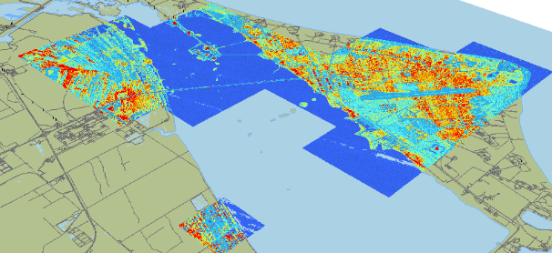
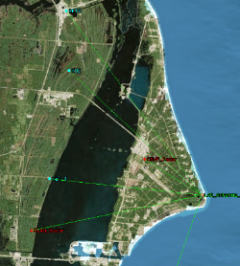
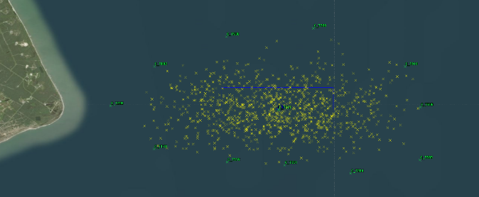

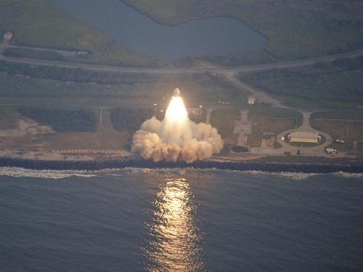
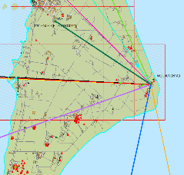
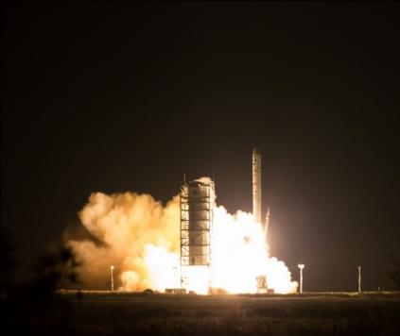
Mission Planning Lab (MPL)
Planetary CubeSats Symposium – August 2018
Ben W. Cervantes

Slide 2
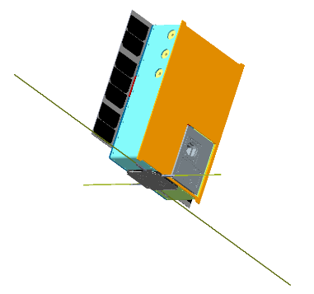
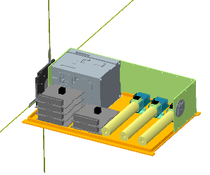
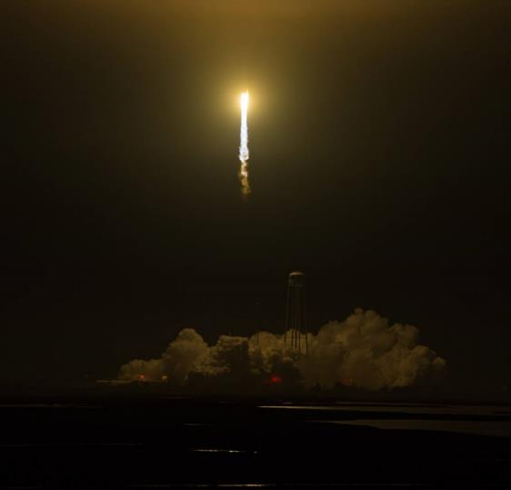
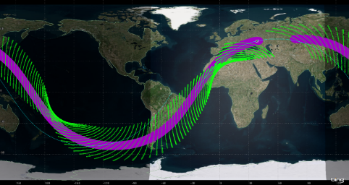
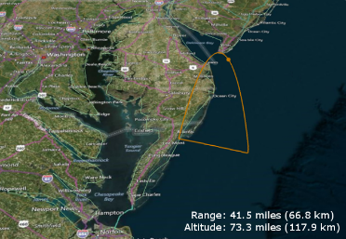
Agenda
MPL Background
Overview
Team, Capabilities, Concept
Architecture Needs
Working with the MPL
Photo Credit: (NASA/Aubrey Gemignani)

Slide 3
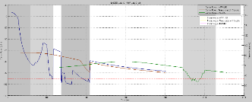
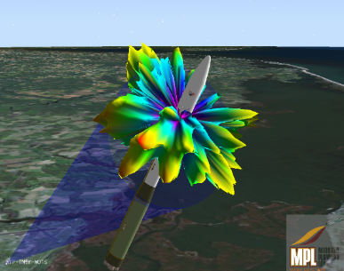
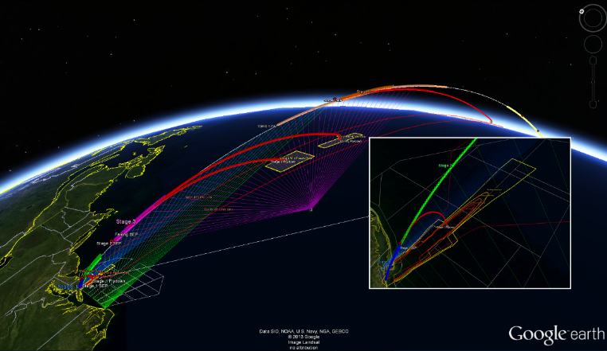
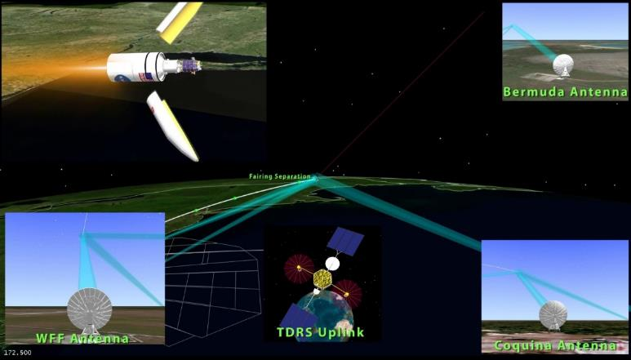
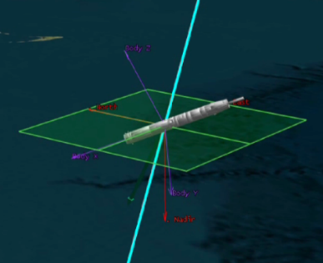
MPL Background
Began as a pre-launch mission formulation and planning capability for WFF
Automated RF link margin analysis for fixed and mobile ground assets
Developed mission simulations & visualizations
Supported sounding rockets, ELVs, and Antares
Requested to expand our capabilities…

Slide 4
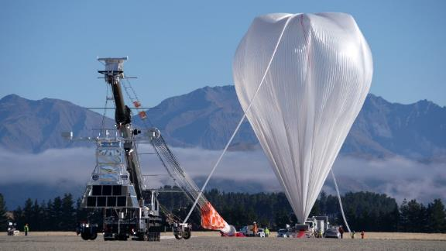
MPL Background
Goal of expanding MPL capabilities to support mission design for suborbital carriers (sounding rockets, balloons, aircraft) and CubeSats / Small Satellites
Augment MPL by leveraging existing GSFC staff
Utilize MPL for pre-mission planning
Conduct and provide studies to PIs for suborbital and CubeSat / Small Sat missions
  Products from studies to assist with proposal development
MPL has been providing studies since 2014
Completed 30 studies and 7 reviews/mini-studies to date
Printing
3D Models
Technical
Budget
Thermal
/ ME
(548)
Compliance
Management
GN&C
(598)
SE
(598)
PDL
(589)
PI
Power
(569)
Cost
Management
MPL
Technical
Review
APO
802
800
Suborbital
Office
Comm.
(569)
Solar
Power
SW
(589)
800
Safety
Link
Analysis
Support
Personnel
Analyst
Visualization
IT

Slide 5
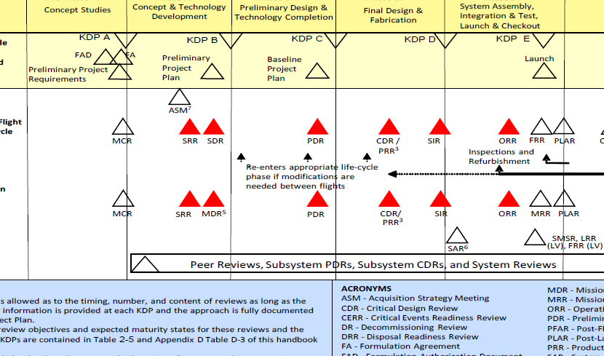
MPL Occurrence

Slide 6
MPL Overview
MPL establishes an environment that facilitates multi-disciplinary, concurrent, collaborative, space system engineering design and analysis activities to enable rapid development of end-to-end mission design concepts
Studies run ~1 week with a discipline engineering report out on final day
Pre-work forms disseminated and meetings are conducted prior to the study
MPL collaborates with the Integrated Design Center (IDC) and leverages support from Greenbelt and Wallops ETD depending on staffing needs and availability
Understand Reqs.,
Trade Studies
ConOps, Tentative HW, Draft Block,
Initial CAD
Baseline HW, Draft CAD
Finalize technical budgets, Work slides
Report out to customer, Q&A, Fix errata
Mon
Tues
Wed
Thurs
Fri

Slide 7
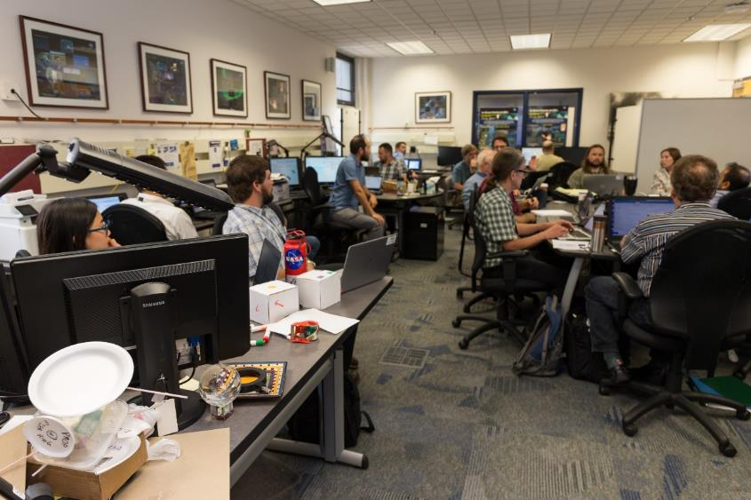
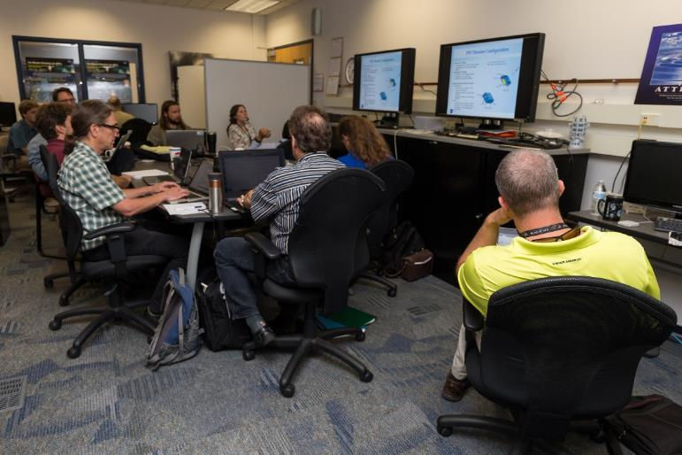
MPL Team / Roles
MPL Lead
Mission Systems Engineer
GNC / ACS
Flight Dynamics
Propulsion
Mechanical
Thermal
Communications
Electrical Power
C&DH / FSW
Radiation
Other SMEs as needed

Slide 8
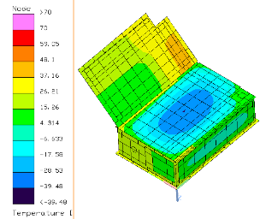
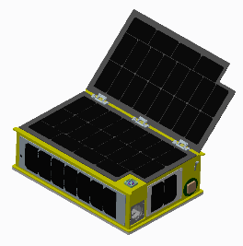
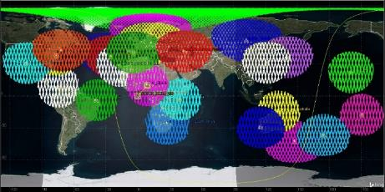
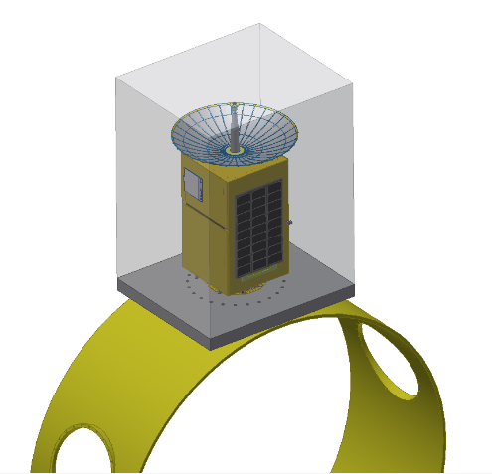
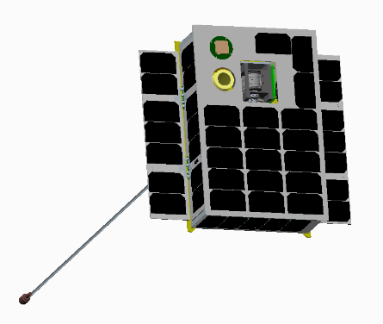
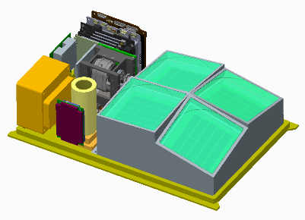
MPL Capabilities / Deliverables
Discipline engineering slides capture requirements, ConOps, cost, trades, assumptions, block diagrams, analysis:
  Systems, GN&C, Mechanical, Thermal, Power, Communications, C&DH/FSW, Propulsion, Flight Dynamics, Radiation
Master Equipment List (MEL)
Mechanical CAD model / STEP file
Thermal model – thermal desktop files
STK scenario / model & additional reports as requested
Cost estimate
Schedule estimate
Orbit lifetime
Package of component spec sheets (bus and instrument)
Administrative products: contact list, support for remote participation, notes and supplemental information for websites referenced, whiteboard images
Notes:
Can also provide mini-studies or MPL reviews of CubeSat / Small Sat concepts.

Slide 9
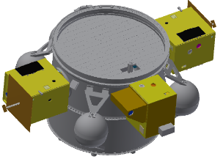
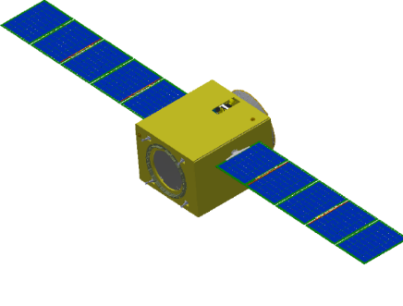
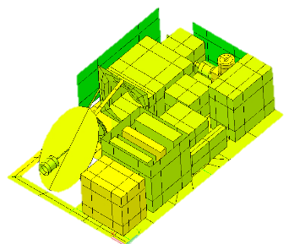
Concept to MPL
PIs Obtain funding for a study
Contact myself (MPL Lead), Jennifer Bracken (IDC Lead), or SSPO Code 851
MPL Lead informed about potential study
MPL Lead works with PI for scheduling a study
MPL Lead, IDC Lead, or Code 851 Manager contacted by or contacts PI
MPL Lead, ETD Management, and IDC Lead work resources meeting to fill staffing gaps
MPL Lead, SE, IDC Lead interface with PI Team, start pre-work
MPL Team & PI Team pre-work clarification meeting
MPL Team 1 week design/feasibility study

Slide 10
Architecture Needs

Slide 11
Architecture Needs
Information gathered from various MPL studies, instruments, and missions
  Didn’t conduct a survey across GSFC Code 600 PIs
Not intended to be an all encompassing list of architectural needs
Studies included 3U, 6U, 12U, ESPA, and ESPA Grande
  Planetary, Heliophysics, Astrophysics, Earth, Technology

Slide 12
Architecture Needs
 | 12U, ESPA, ESPA Grande | 3U, 6U
Mission | Planetary, Heliophysics | Heliophysics, Astrophysics, Earth
Instrument Power (W) | 13 to 80 W | 1.2 to 10.3 W
Mass (kg) | 3 to 40 kg | <1 to 4 kg
Volume (U) | 1.3 to 52.5 U | 1.5 to 4 U
Pointing Control | 5 asec to (+/-) 1 deg | 0.5 to 15 deg
Pointing Knowledge | 10 asec to (+/-) 1 deg | <0.2 to 1 deg
Data | 1.3 GB total to 2 GB/day | 5 MB/day to 2 GB/day
TID (krad) | 5 to 120 | ---
Power (W) | 31 to 110 (science) 115 to 210 (prop) | 8 to 20 Whrs/orbit 5 to 17 W
Destination / Environment | Venus, Mars, Comet, Moon, Heliocentric, L1, deep space | LEO ISS, Sun Synch
S/C Total Mass (kg) | 24 to 120, 220 kg | 3.5 to 5.5; 9 to 14.5 kg

Slide 13
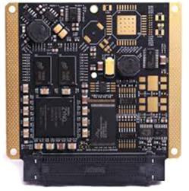
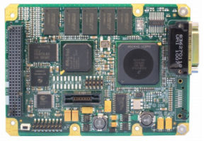
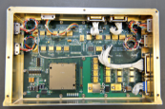
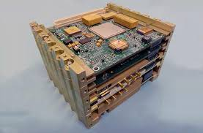
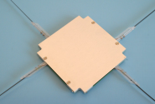
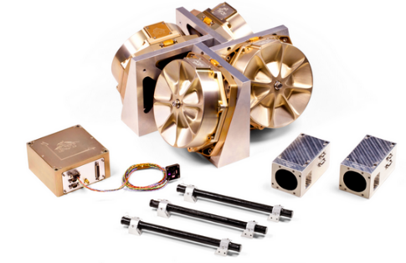
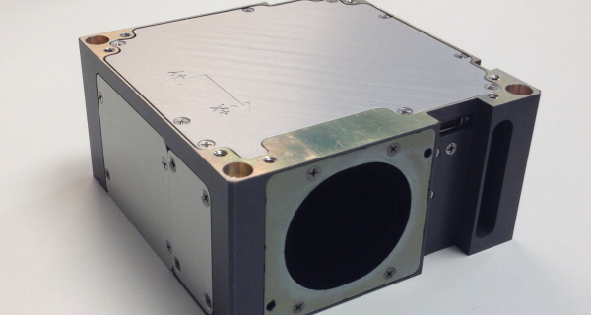
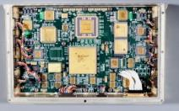
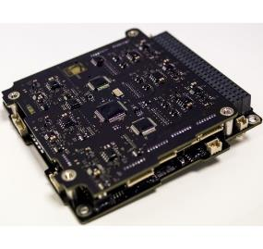
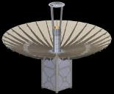
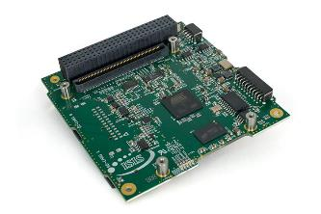
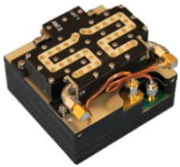
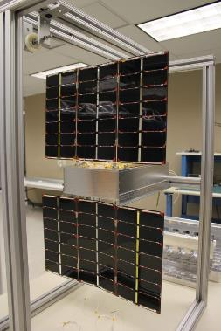
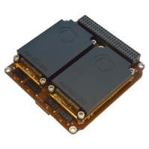
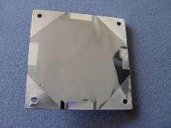
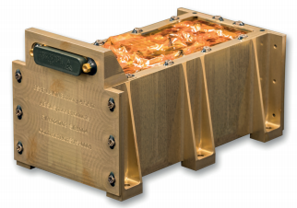
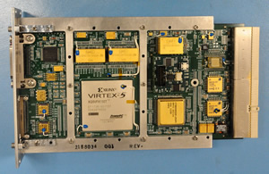
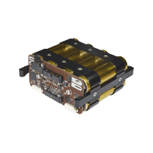
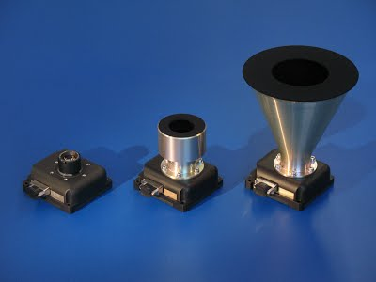
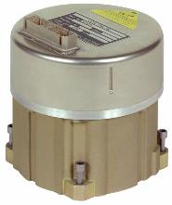
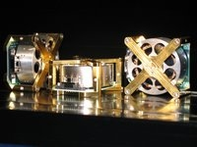








Architecture Trades
C&DH
Communications
Communications
Power
GMSA
MUSTANG
Clyde Space
GOMSpace
Andrews Space
ABSL
MMA
BCT
Pumpkin
In-House
Thermal
ADCS
BCT XACT
BCT Flexcore
Sinclair RWS
Sinclair ST-16
LN-200 IMU
Sensonor
Novatel OEM 615
CSS, MSS
Gravity gradient
Communications
L3 Cadet
Innoflight SCR-100
JPL Iris V2
Tethers Swift
AntDevCo
MMA
ISIS
ADCS
C&DH
GMSA
MUSTANG
  Modular Unified Space Technology Avionics for Next Generation
SpaceCube
GOMspace NanoMind
CHREC Space Processor
ISIS On Board Computer
Space Micro Proton 400k
Pumpkin
Power
ADCS
Power
Mechanical
Propulsion

Slide 14
Working with the MPL
NASA GSFC Code 600 Sciences and Exploration Directorate PI
  External Co-I
External PI with GSFC Co-I
External PI w/out GSFC Co-I
  NASA GSFC Code 102 Strategic Partnership Office to establish agreement

Slide 15
Past Initiatives to Collaborate
Internal
  IRAD
  B&P
Planetary Science Deep Space SmallSat Studies (PSDS3)
  Proposals were due Fall 2016
  Supported studies Fall 2017 – Spring 2018
Astrophysics Science SmallSat Studies (AS3)
  Proposals were due July 2018
  Support studies next FY

Slide 16
It Takes a Team – Thank You
Name | Role
Will Mast | Systems Engineer
Scott Heatwole | GN&C
Zach Peterson | GN&C
Tom Widmyer | Mechanical
Caitlin Gibbons | Mechanical
Leyland Young | Thermal/Mechanical
Lindsey Seo | Thermal
Nathan Cordrey | Thermal/Mechanical
Marta Shelton | Communications
Brian Banks | Communications
Amy Davis | Communications
Chris Purdy | Electrical Power
Scott Hesh | Electrical Power
Megan Casey | Radiation
David Batchelor | Radiation
Name | Role
Tom Johnson | Head SSPO
John Hudeck | Deputy SSPO
Tom Dixon | Deputy SSPO
Jennifer Bracken | IDC Lead
Ben Cervantes | Team Lead / C&DH / FSW
Mike Matthews | C&DH / FSW
Eric Pollack | C&DH / FSW
Bob Stancil | C&DH / FSW
Ted Daisey | C&DH / FSW
Dave Folta | Flight Dynamics
Kyle Hughes | Flight Dynamics
Sabrina Thompson | Flight Dynamics
Khary Parker | Propulsion
Eric Golliher | Propulsion
Brenda Dingwall | APO, Small Sat

Slide 17


Contact Information
Ben Cervantes, MPL Lead
Benjamin.w.cervantes@nasa.gov
Desk: 757-824-1526
MPL: 757-824-2594
Jennifer Medlin Bracken,
Integrated Design Center Manager
Jennifer.M.Bracken@nasa.gov
Tom Johnson
Head, Small Satellite Project Office
Thomas.e.johnson@nasa.gov
MPL website: http://sites.wff.nasa.gov/mpl
Wallops Mission Status Center:
https://sites.wff.nasa.gov/wmsc

