Slide 1
Multi-point SmallSat Missions at Mars
Jared Espley
Laboratory for Planetary Magnetospheres (695)
Goddard Space Flight Center

Slide 2
Take home message
Multiple SmallSats in orbit at Mars can do great science
Specific science examples:
Mars’ time variable hybrid magnetosphere and the implications for the evolution of atmospheres
Geophysical history of the martian surface (e.g. did Mars ever have plate tectonics?)
These missions are challenging technically (e.g. propulsion) and financially
But possible now or in the near future
Contact: Jared.Espley@nasa.gov

Slide 3
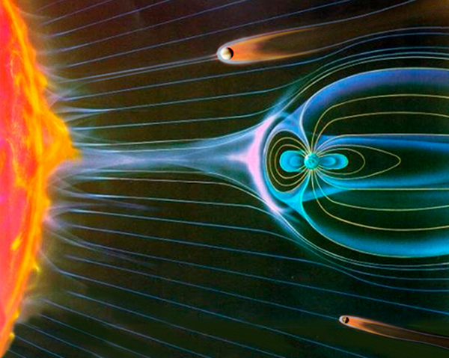
Induced martian magnetosphere
Notes:
Mars lacks an intrinsic planetary magnetic field
Instead induced currents create an induced magnetosphere
Solar wind flows directly onto the atmosphere

Slide 4
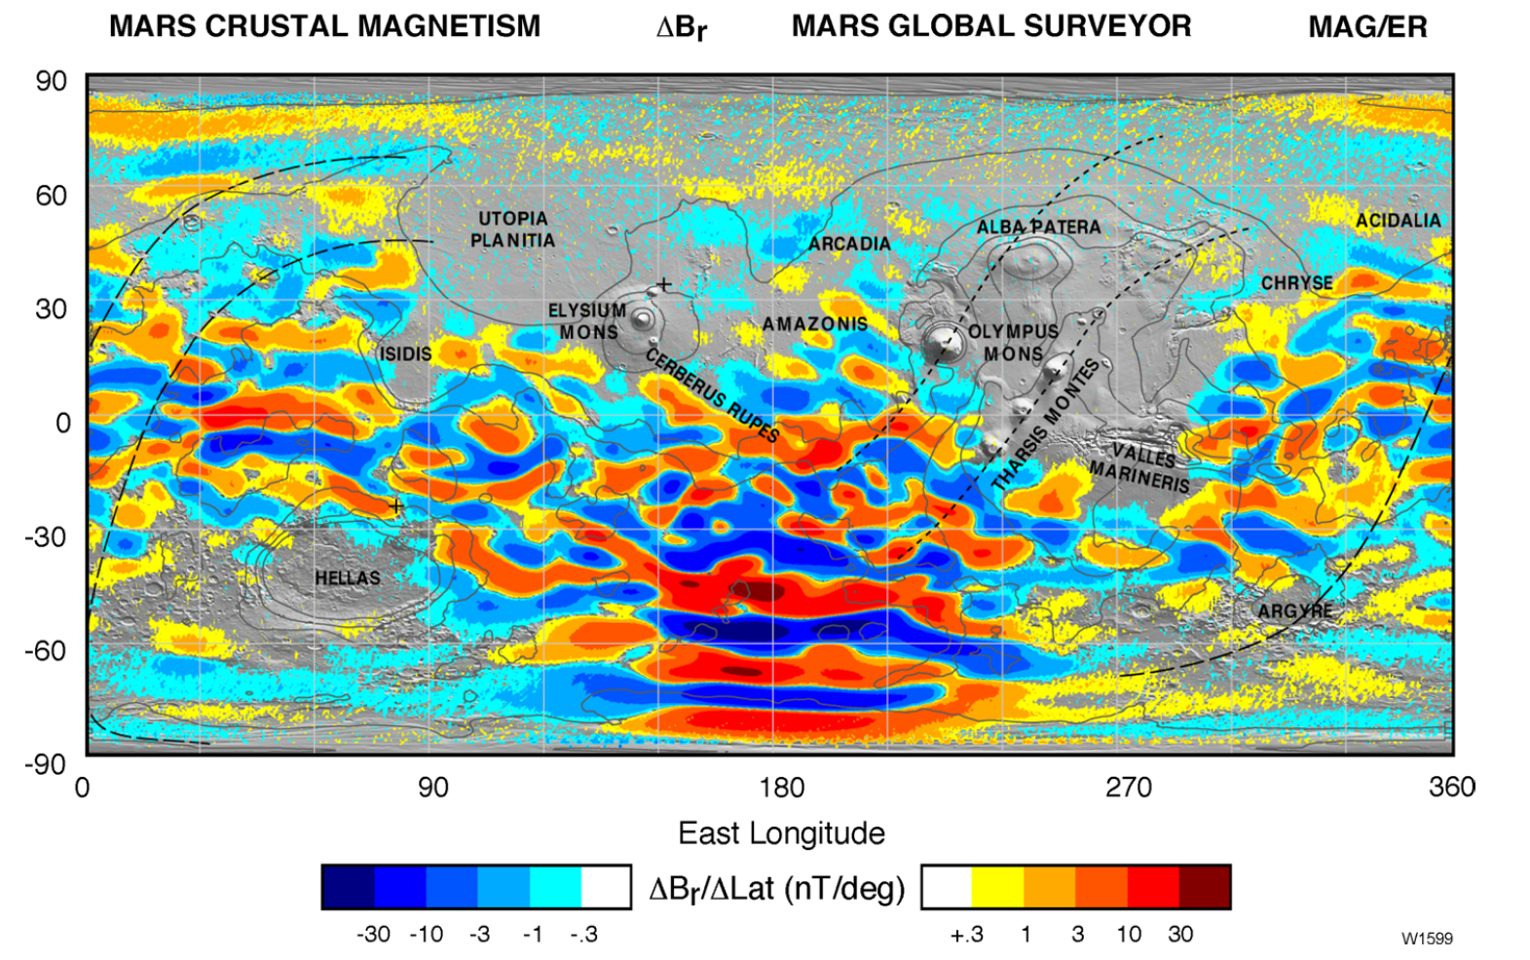
Mars crustal magnetism

Slide 5
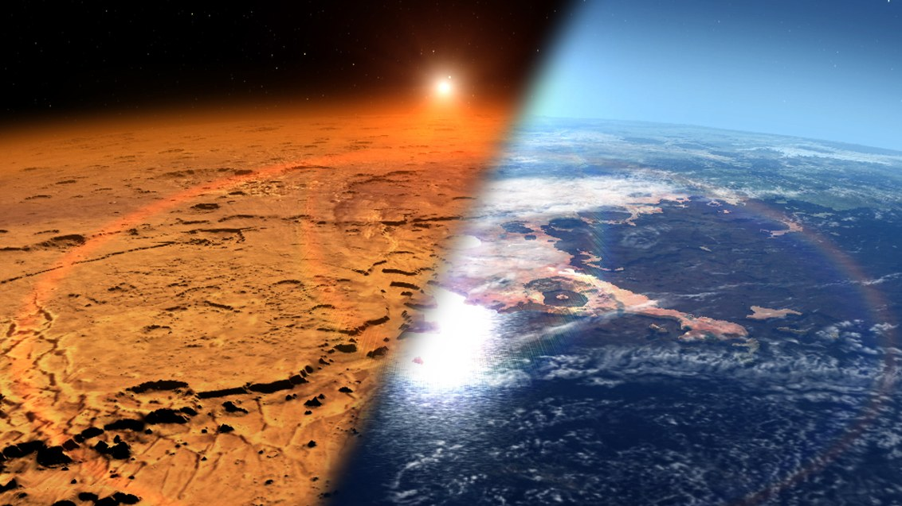
Solar wind erosion at Mars (& exoplanets?)
Warm & wet -> Cold & dry

Slide 6
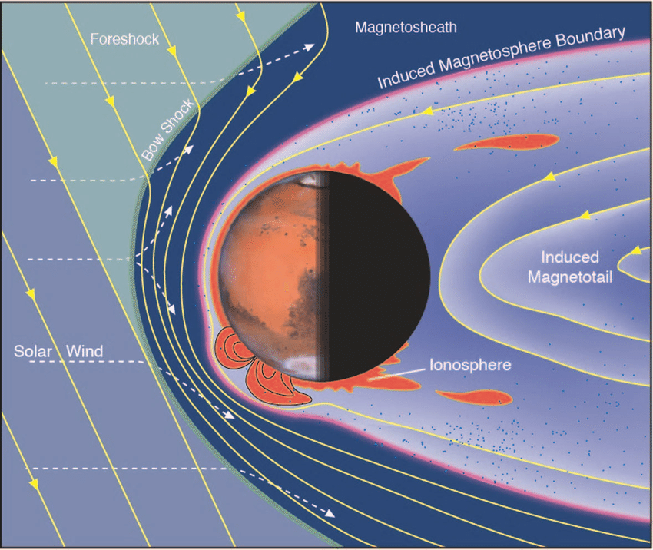
Mars’ hybrid magnetosphere
Image: D. Brain/LASP
A natural plasma physics laboratory

Slide 7
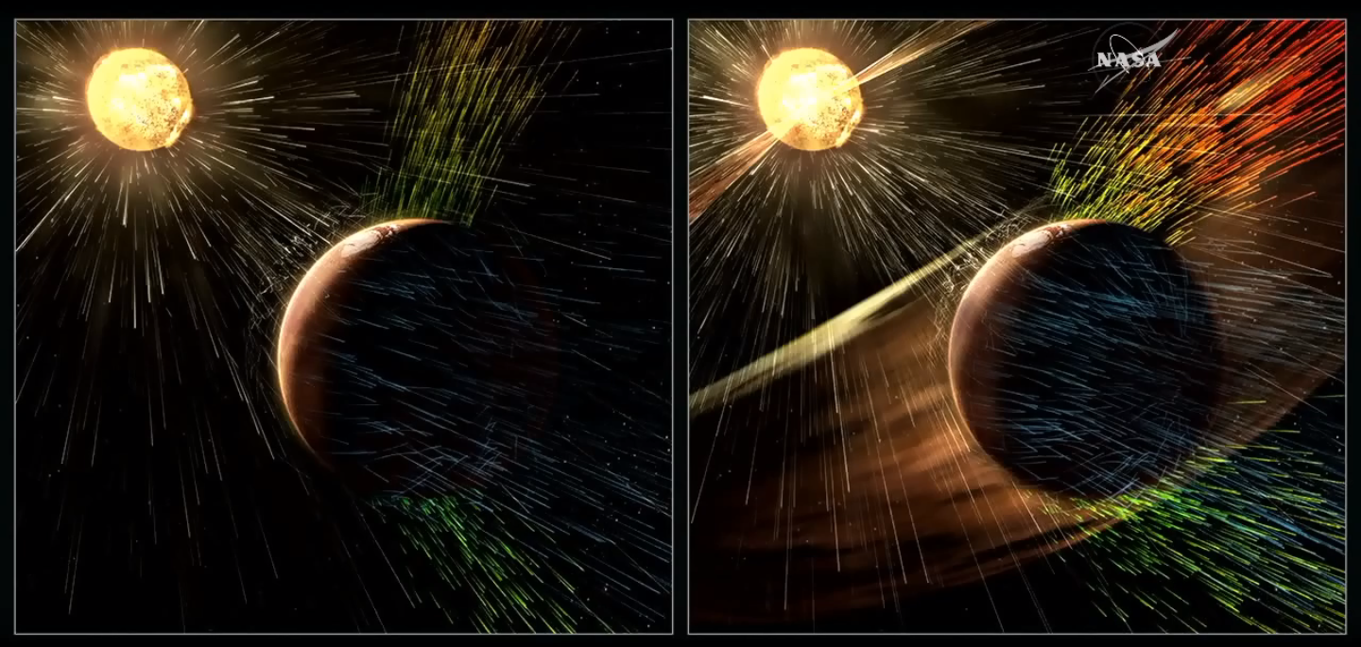
Time variable vs. spatially variable

Slide 8
Time variable vs. spatially variable

Slide 9
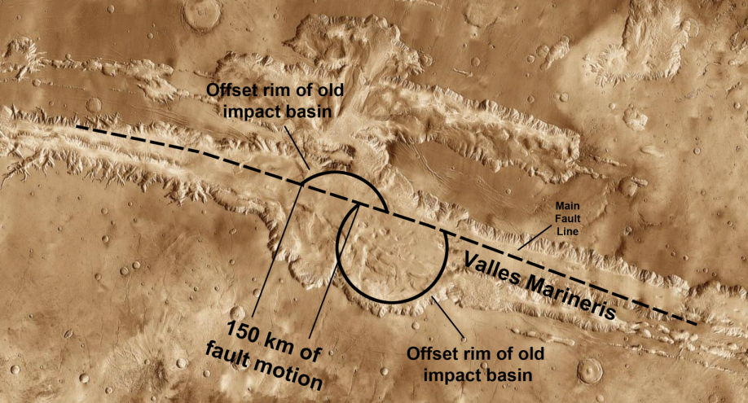
Magnetic gradiometry: Higher spatial resolution crustal field maps
Did Mars have plate tectonics?

Slide 10
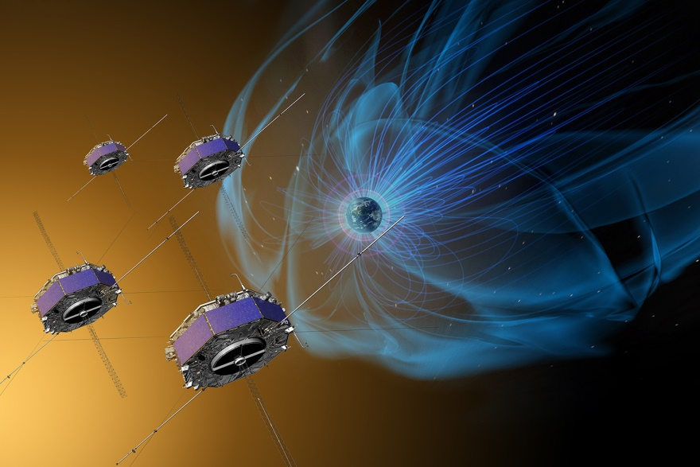
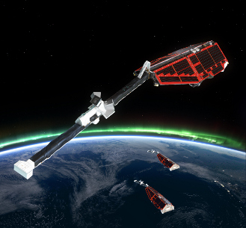
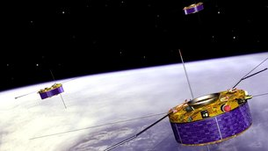
Multi-point terrestrial missions
MMS
Swarm
Cluster

Slide 11
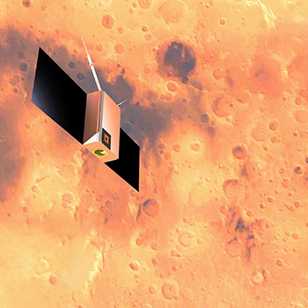
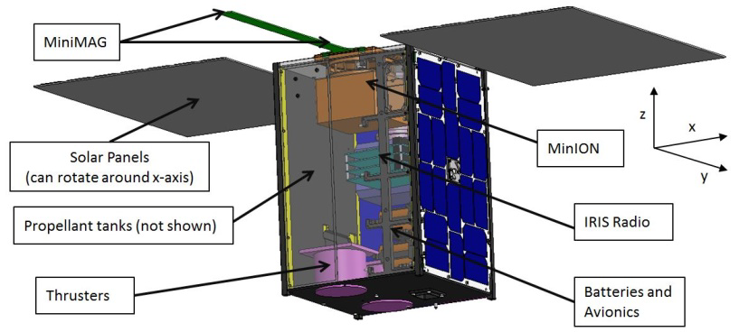
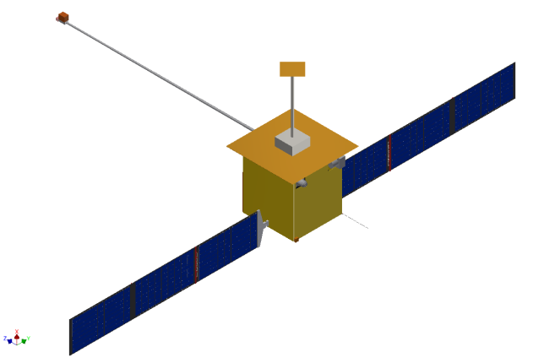
Multi-point Mars mission concepts
MarsCat, Bering/U. Houston
MISEN, Lillis/UC-Berkeley
M4, Espley/GSFC

Slide 12
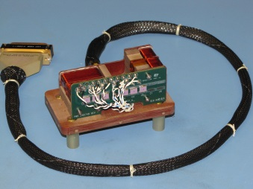
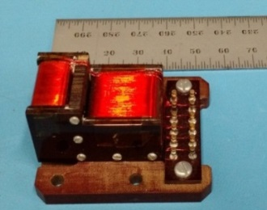
Example SmallSat instrument: GSFC mini-fluxgate magnetometer
 | Standard Mag | Mini-mag
Heritage | MAVEN, Juno | Polar Orbiting Geomagnetic Survey
Sensor Technology | Fluxgate (1’’ ringcore) | Fluxgate (5/8’’ ringcore)
Sensor: Mass Volume | 400g 400 cm³ | 40g 60 cm³
Electronics: Mass Volume | 700 g 700 cm³ | 200g 200 cm³
Power | ~1W | < 1 W
Instrument Capability | ~0.01 nT | ~0.1 nT

Slide 13
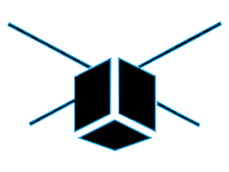
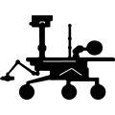
Types of Rideshares to Mars Orbit
Rideshare via Mars orbiter
Rideshare via Mars lander
Rideshare via Earth-bound orbiter

Slide 14
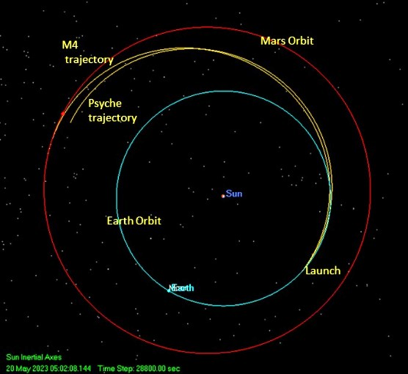
Trajectory/Propulsion
Propulsion options:
Solar electric prop (SEP)
Green prop
Chemical prop
Tradespace
Flight times (<3 years?)
Technology Readiness Level (TRL)
Total wet mass needed to deliver 20+ kg of dry mass
Challenging but doable?
Doable soon?

Slide 15
Classes of NASA Planetary Missions
TraditionalCubeSats
??
SIMPLEx
Discovery
New Frontiers
$10m
$50m
$100m
$500m
$1000m
Helio/Astro: SMEX
MIDEX

Slide 16
Classes of NASA Planetary Missions
TraditionalCubeSats
PSD SMEX/MIDEX?
SIMPLEx
Discovery
New Frontiers
$10m
$50m
$100m
$500m
$1000m

Slide 17
Take home message
Multiple SmallSats in orbit at Mars can do great science
Specific science examples:
Mars’ time variable hybrid magnetosphere and the implications for the evolution of atmospheres
Geophysical history of the martian surface (e.g. did Mars ever have plate tectonics?)
These missions are challenging technically (e.g. propulsion) and financially
But possible now or in the near future
Contact: Jared.Espley@nasa.gov

Slide 18
Extras

