Slide 1
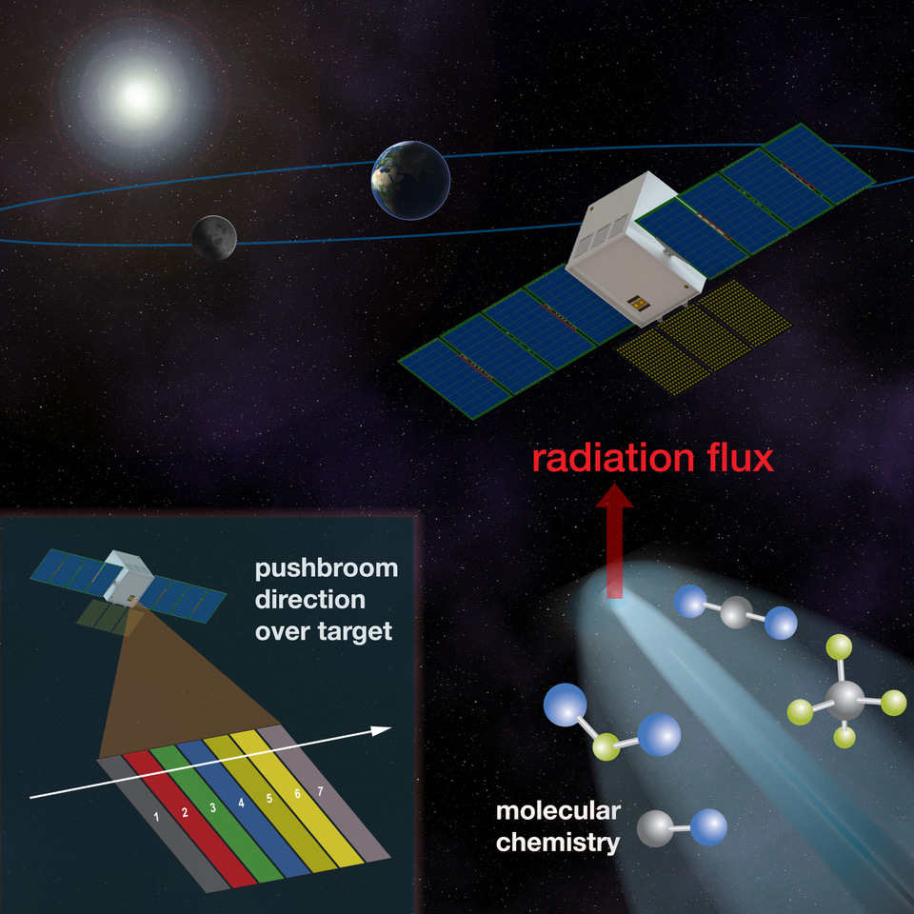
Primitive Object Volatile Explorer (PrOVE) – Waypoints and Opportunistic Deep Space Missions to Comets
Summary
• A new or long period comet flyby will yield unprecedented science.
- New comet missions: limited time to develop/launch a spacecraft after discovery.
- Periodic comet missions: potentially involves mission risk with launch platform delays.
• Solution: Waypoints in space.
• CubeSats/SmallSats are a cost efficient pathway for parking a spacecraft pending a new comet.
• PrOVE payload goal is to acquire 8-m spatial resolution images of nucleus, volatile inventory and temperatures of a new or periodic comet.
Notes:
Waypoint is a parking orbit
67P is – JFC - not a new comet
Waypoints enable missions to NEW comets
Waypoints retire launch delay risk for low thrust CubeSats to periodic comets

Slide 2







University of Maryland
Tilak Hewagama
James Bauer
Lori Feaga
Tim Livengood
Jessica Sunshine
GSFC & WFF
Shahid Aslam
Dave Folta
John Hudeck
Terry Hurford
Kyle Hughes
Donald Jennings
Michael Mumma
Conor Nixon
Geronimo Villanueva
Morehead State University
Ben Malphrus
Kevin Brown
York University
Michael Daly
JPL
Pamela Clark
Catholic University of America
Nicolas Gorius

Slide 3
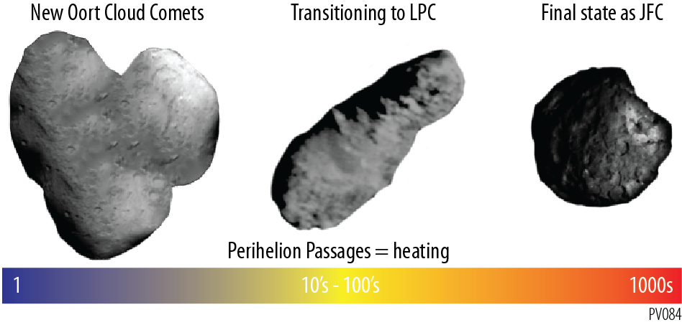
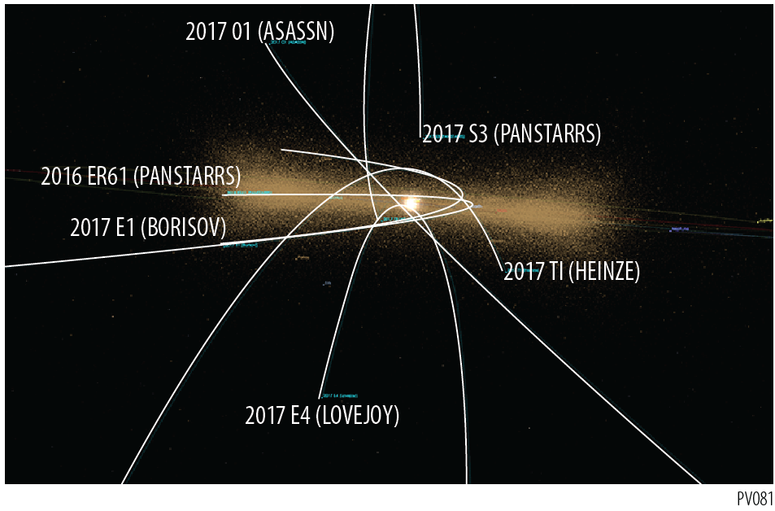
Background
Images the nucleus of a new comet to investigate whether it formed by accreting discrete cometesimals and, if so, how they came together;
Explores the inventory and distribution of volatiles across the nucleus;
Investigates the surface albedo at a fundamental level to reveal if it is an unevolved nucleus darker or brighter than periodic comets;
Determines the impact history of an outer Solar System object through the cratering record on its surface;
Examines layering by imaging the structure within its impact craters at high resolution;
Investigates features unique to comets due to sublimation by imaging the structure of a surface in its first perihelion passage;
Bookends the population of comets, from the highly evolved short-period comets visited by earlier missions to the new OCC that will be visited for the first time by PrOVE.
Notes:
Waypoint is a parking orbit
67P is – JFC - not a new comet
Waypoints enable missions to NEW comets
Waypoints retire launch delay risk for low thrust CubeSats to periodic comets

Slide 4
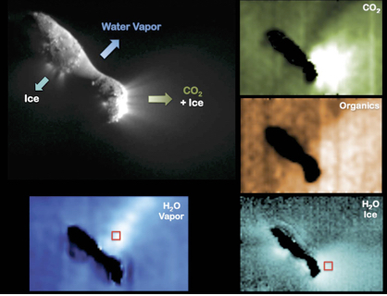
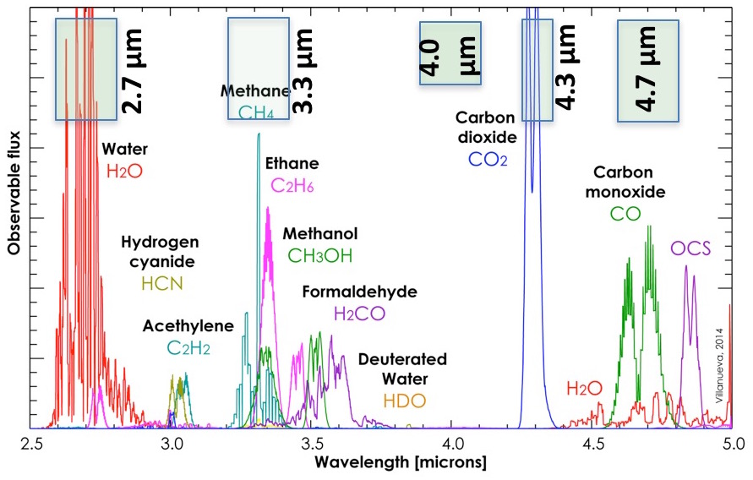
Science Objectives:
PrOVE will perform a close flyby of a new or young (long-period) comet near perihelion when surface processes and volatile activity are maximum, to probe the origin of the nucleus and the formation and evolution of our Solar System.
Deep Impact, Hartley 2
Mission Goals
Investigate morphological and chemical heterogeneity of nucleus by quantifying surface fine structure and volatile species abundances, and how these depend on solar insolation;
Map surface relief and spatial distribution of volatiles, especially CO₂ (which cannot be measured from ground based telescopes), and determine any variations;
Determine the frequency and distribution of outbursts.
CHNOPS

Slide 5
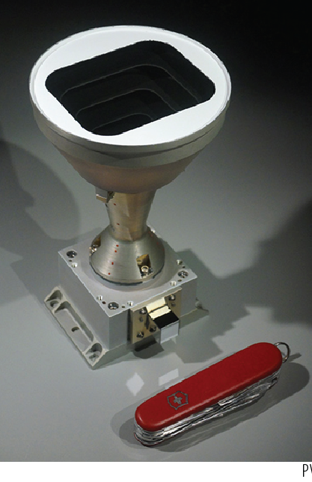
Payloads
Infrared Imager/radiometer
Visible Imager
ComCAM: IR microbolometer (with TEC) has broad spectral response (1-100 µm) which includes science requirements of 2-5 µm for molecular species and 8-12 µm for thermal.
VisCAM: High spatial resolution mapping of a Jupiter-family comet surface is optimum. Mapping of a new comet would be unprecedented.
Notes:
IR 2-12 µm generally requires dual focal planes.

Slide 6
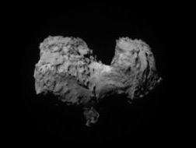
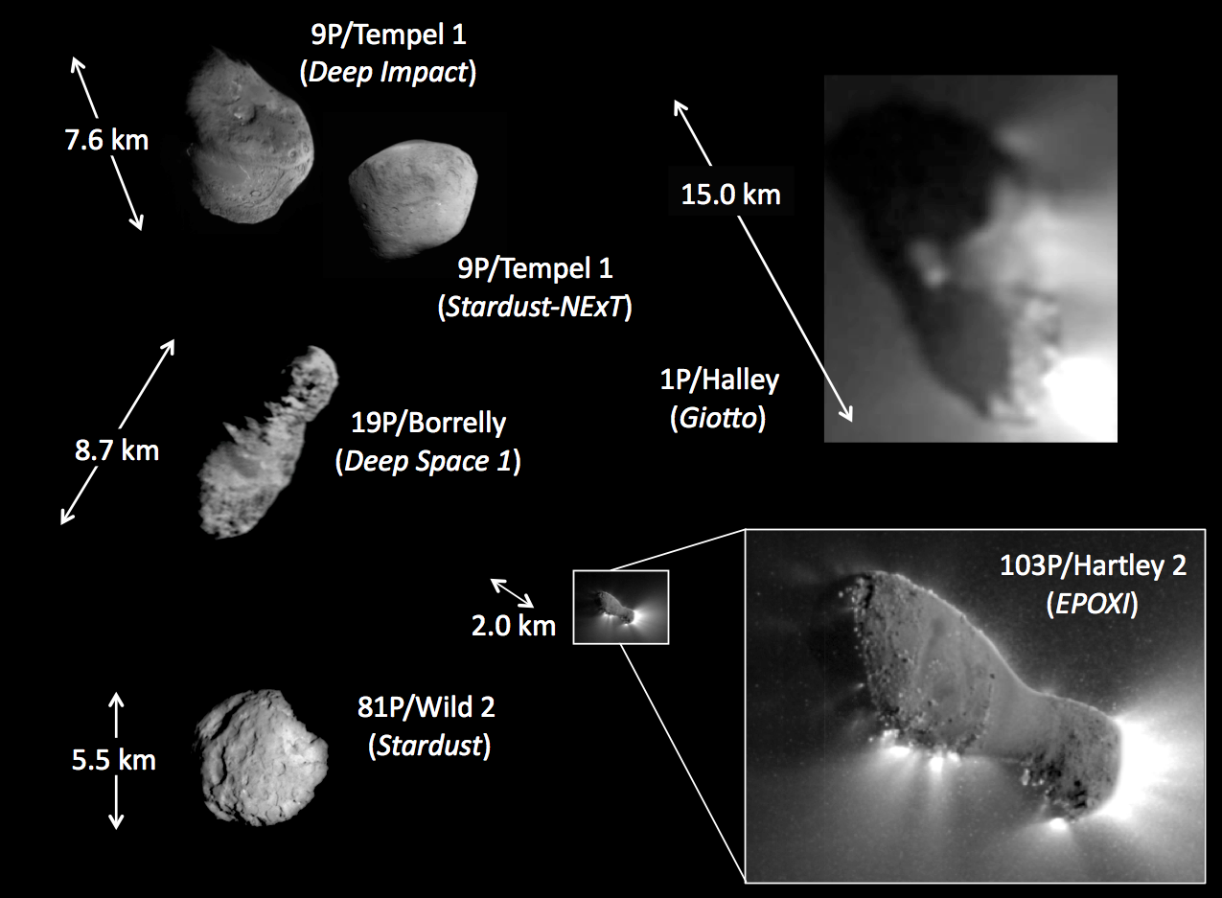
Relevance
NASA Science Plan
The Planetary Science program includes “robotic space probes to ….. asteroids and comets” and has “Small bodies: Comets, asteroids, and the dwarf planet Ceres” as a major mission class.
These are the only cometary nuclei that we have images of.
Visions & Voyages (decadal)
Comet composition and thermal environment are relevant to crosscutting themes of Building new worlds, Planetary habitats, and Workings of solar systems.
New/young comets probe the early solar system formation and history.
Missions to date: only flybys of periodic comets!
Benefit to taxpayers
Comets and comet missions garner significant public interest and awareness.
67P/C-G
(Rosetta)
5 km

Slide 7
Why Waypoints
New comets:
Hale-Bopp discovery was 2 years prior to perihelion.
Many long-period comets are discovered with even shorter times.
Proposed solution:
Park a spacecraft in space.
Statistics of Oort cloud comets:
Statistics over past 10 years indicate 1 detected every 2 years. Hughes (2001) estimates the historical long-period comet flux as ~1 per year.
Close flyby to study nucleus of a long-period comet:
Surface maps of ~8-m resolution and volatile inventory will yield compelling scientific results.
Insufficient lead time for a mission
Technology advances in CubeSats/SmallSats enable cost-efficient opportunities
Spacecraft lifetime of ~4 years
CubeSat/SmallSat missions can risk close flyby operations
Mission to a new comet is within contemporary SmallSat technology!

Slide 8
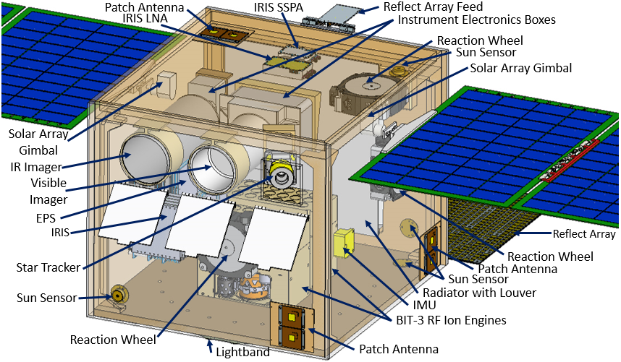
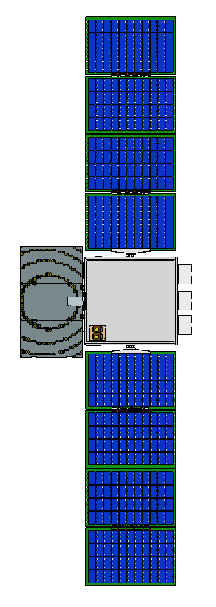
Spacecraft
EPSA Class Spacecraft
Wet Mass: <50 kg (w/margin)
Dimensions: 18” x 18” x 19.2”

Slide 9
Thank you!
We gratefully acknowledge
• PSDS3 program
• GSFC

